Slide 1
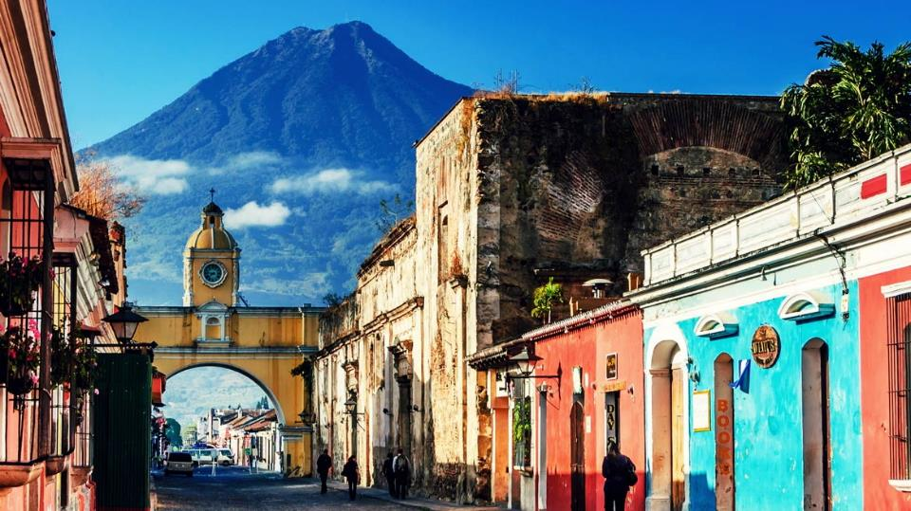
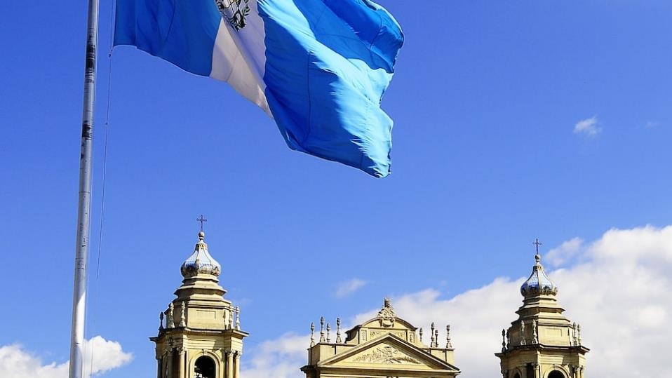
GUATEMALA
National Holidays
Free Template
Here is where your presentation begins
slidesppt.net
Notes:
slidesppt.net

Slide 2
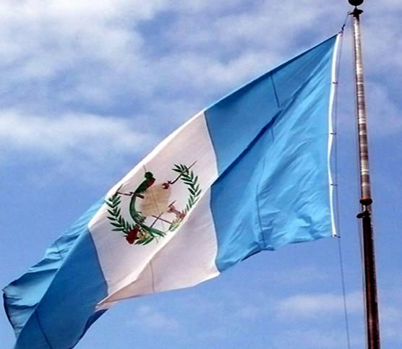
You can simply impress your audience and add a unique zing and appeal to your Presentations. Easy to change colors, photos and Text. Get a modern PowerPoint Presentation that is beautifully designed.
Modern Portfolio Presentation
Notes:
slidesppt.net

Slide 3
01
02
03
TABLE OF CONTENTS
04
MERCURY
Mercury is the closest planet to the Sun
VENUS
Venus has a beautiful name, but it’s terribly hot
MARS
Despite being red, Mars is actually a cold place
JUPITER
It’s the biggest planet in the Solar System
Notes:
slidesppt.net

Slide 4

WHOA!
This could be the part of the presentation
where you can introduce yourself, write your email…

Slide 5

—SOMEONE FAMOUS
“This is a quote, words full of wisdom that someone important said and can make the reader get inspired.”
Notes:
slidesppt.net

Slide 6
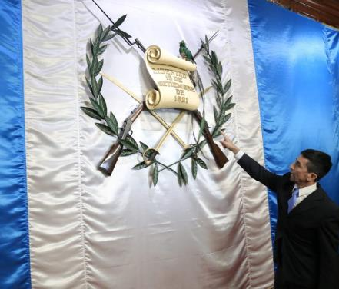
01
GET LOST, AND FIND YOUR TRUE SELF
You could enter a subtitle here if you need it

Slide 7

THE SLIDE TITLE
GOES HERE!
Do you know what helps you make your point clear? Lists like this one:
They’re simple
You can organize your ideas clearly
You’ll never forget to buy milk!
And the most important thing: the audience won’t miss the point of your presentation.
Notes:
slidesppt.net

Slide 8
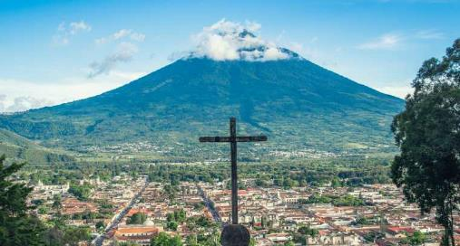
MAYBE YOU NEED TO DIVIDE THE CONTENT
MERCURY
VENUS
Mercury is the closest planet to the Sun and the smallest one in the Solar System and a bit larger than the Moon
Venus has a beautiful name and is the second planet from the Sun. It’s terribly hot—even hotter than Mercury

Slide 9
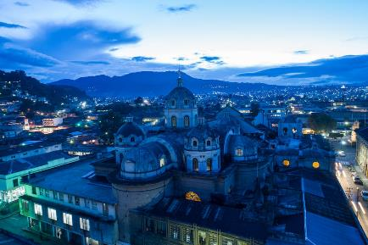
YOU COULD USE THREE COLUMNS, WHY NOT?
MARS
JUPITER
VENUS
Despite being red, Mars is actually a cold place full of iron oxide dust
It’s a gas giant, the biggest planet in the Solar System
Venus has a beautiful name and is the second planet from the Sun
Notes:
slidesppt.net

Slide 10
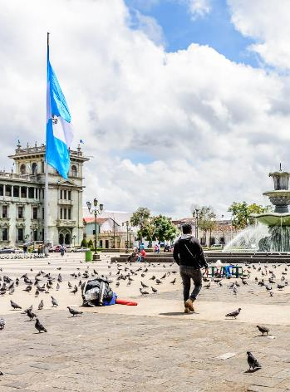
A PICTURE ALWAYS REINFORCES THE CONCEPT
Images reveal large amounts of data, so remember: use an image instead of long texts

Slide 11
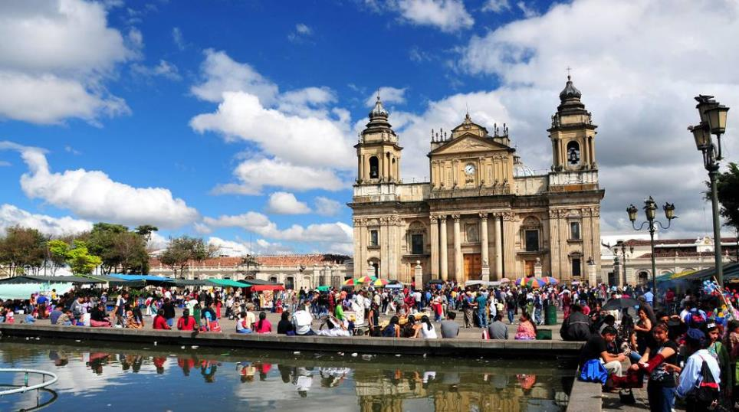
A PICTURE IS WORTH A THOUSAND WORDS
Notes:
slidesppt.net

Slide 12
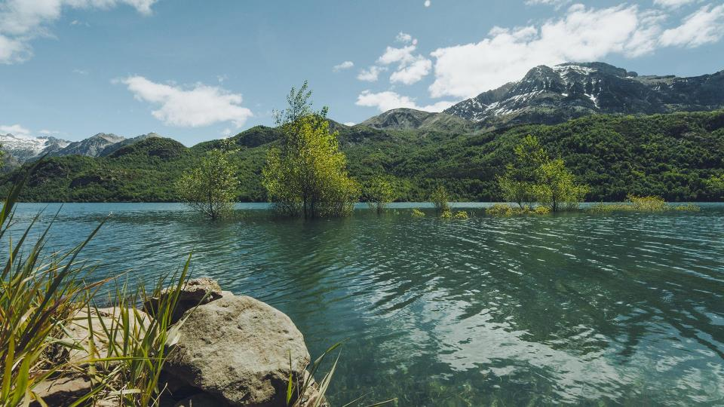
FREE
TEMPLATE
Because key words are great for catching your audience’s attention

Slide 13
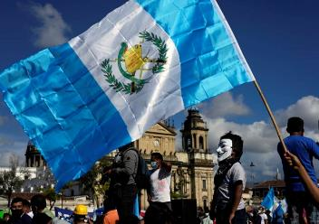
USE A GRAPH TO SHOW YOUR DATA
MERCURY
Mercury is the closest planet to the Sun
VENUS
Venus has a beautiful name, but terribly hot
To modify this graph, click on it, follow the link, change the data and paste the resulting graph here, replacing this one
Notes:
slidesppt.net

Slide 14
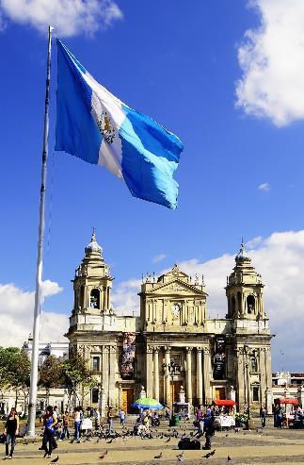
USE A GRAPH TO SHOW YOUR DATA
20%
Despite being red, Mars is actually a cold place
To modify this graph, click on it, follow the link, change the data and paste the resulting graph here
80%
Mercury is the closest planet to the Sun

Slide 15
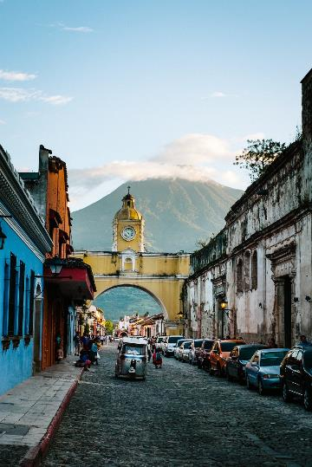
SOMETIMES, REVIEWING CONCEPTS IS A GOOD IDEA
MERCURY
VENUS
Mercury is the closest planet to the Sun
Venus has a beautiful name, but it’s very hot
JUPITER
SATURN
It’s the biggest planet in the Solar System
Saturn is the ringed one and a gas giant
Notes:
slidesppt.net

Slide 16

HOW ABOUT FOUR COLUMNS?
MARS
SATURN
Despite being red, Mars is actually a cold place
Saturn is the ringed one and a gas giant
MERCURY
VENUS
Mercury is the closest planet to the Sun
Venus has a beautiful name, but terribly hot

Slide 17
INFOGRAPHICS MAKE YOUR IDEA UNDERSTANDABLE…
MARS
SATURN
Despite being red, Mars is a cold place
Saturn is the ringed one and a gas giant
MERCURY
VENUS
Mercury is the closest planet to the Sun
Venus has a beautiful name, but terribly hot
Notes:
slidesppt.net

Slide 18
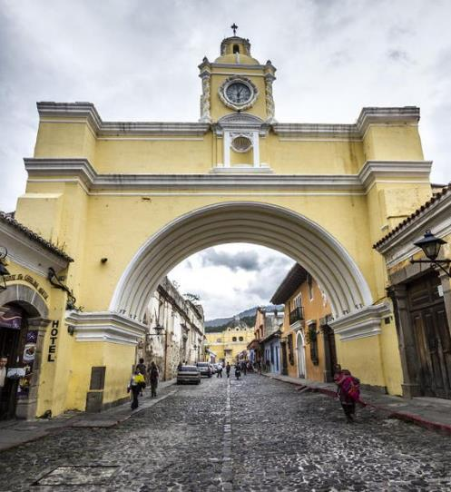
02
NOT ALL WHO WANDER ARE LOST
You could enter a subtitle here if you need it

Slide 19
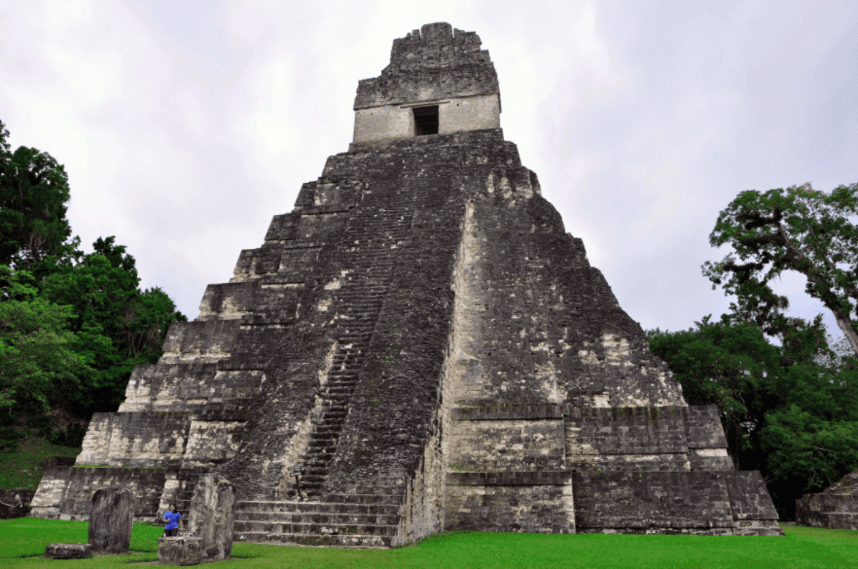
THIS TEXT SEEMS TO BE IMPORTANT...
Mercury is the closest planet to the Sun and the smallest one in the Solar System—it’s only a bit larger than the Moon
Notes:
slidesppt.net

Slide 20
THIS IS A MAP
MARS
Mars is actually a cold place full of iron oxide dust

Slide 21
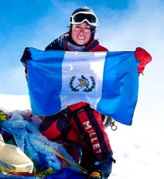

THE
ADVENTURE PARTNER
ADVENTUROUS ANNIE
BRILLIANT BARNEY
You could talk a bit about this person here
You could talk a bit about this person here
Notes:
slidesppt.net

Slide 22
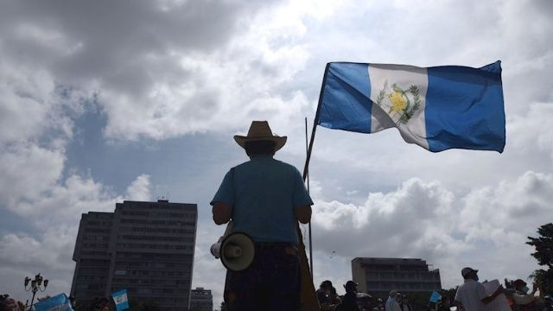
OUR CONSULTANTS
HELENA PATTERSON, 32
You can replace the image on the screen with your own

Slide 23
A TIMELINE ALWAYS WORKS WELL
MARS
MERCURY
SATURN
VENUS
Despite being red, Mars is a cold place
Mercury is the closest planet to the Sun
Saturn is the ringed one and a gas giant
Venus has a beautiful name, but terribly hot
Notes:
slidesppt.net

Slide 24
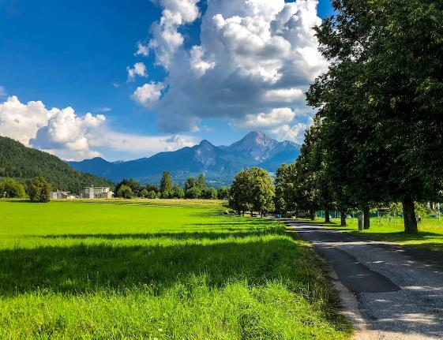
UPCOMING GOALS
GOAL 1
Neptune is the farthest planet from the Sun
GOAL 2
Saturn is composed mostly of hydrogen and helium
GOAL 3
Despite being red, Mars is actually a cold place
Notes:
slidesppt.net

Slide 25
OR TRY THIS TIMELINE
Despite being red, Mars is actually a cold place
MONDAY
Mercury is the closest planet to the Sun
WEDNESDAY
Saturn is the ringed one and a gas giant
FRIDAY
Venus has a beautiful name, but it’s hot
SATURDAY
Notes:
slidesppt.net

Slide 26

7,498,300
Big numbers catch your audience’s attention

Slide 27
HERE ARE SOME PERCENTAGES
MERCURY
VENUS
MARS
Mercury is the closest planet to the Sun
Venus has a beautiful name, but it’s very hot
Despite being red, Mars is actually a cold place
Notes:
slidesppt.net

Slide 28
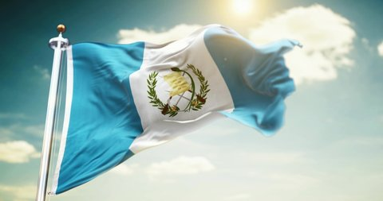
A TIMELINE ALWAYS WORKS WELL
Mercury is the closest planet to the Sun and the smallest one in the Solar System—it’s only a bit larger than the Moon
93%
35%
You can do wherever you want when you believe in yourself
You can do wherever you want when you believe in yourself
Notes:
slidesppt.net

Slide 29
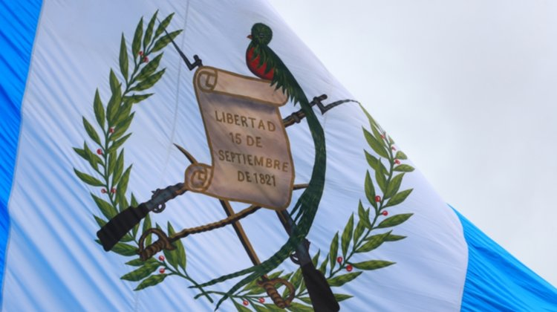
386,000 km
333,000.00
24h 37m 23s
separate Earth and the Moon
earths is the Sun’s mass
is Jupiter’s rotation period
Mercury is the closest planet to the Sun and the smallest one in the Solar System—it’s only a bit larger than the Moon
Notes:
slidesppt.net

Slide 30
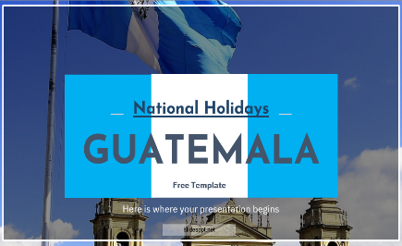
DESKTOP SOFTWARE
You can replace the image on the screen with your own work. Just delete this one, add yours and center it properly

Slide 31
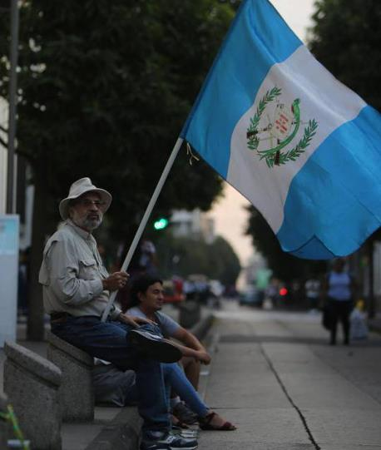

THANKS!
Do you have any questions?
You can replace the image on the screen with your own work. Just delete this one, add yours and center it properly
Free Template
Notes:
slidesppt.net

Slide 32
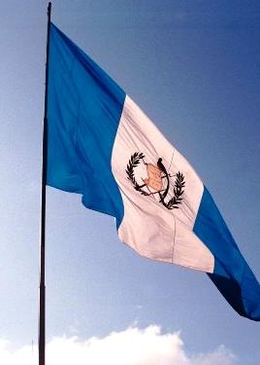
FUENTE
ELABORADO POR : slidesppt.net
IMAGES :
unsplash.com
redbubble.com
prensalibre.com
freedomhouse.org
elpais.com
republica.gt
thanhtra.com
FONTS :
Josefin Sans
IBM Plex Sans
slidesppt.net
Notes:
slidesppt.net

Slide 33
Resources
Notes:
slidesppt.net

Slide 34
Fully Editable Icon Sets: A
Notes:
slidesppt.net

Slide 35
Fully Editable Icon Sets: B
Notes:
slidesppt.net

Slide 36
Fully Editable Icon Sets: C
Notes:
slidesppt.net

