Slide 1
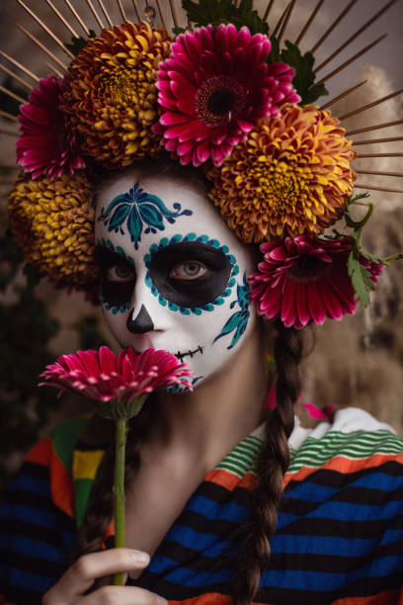
THE CATRINA
Free Template
Here starts the presentation
slidesppt.net
Notes:
slidesppt.net

Slide 2
“This is a quote, words full of wisdom that someone important said and can make the reader get inspired.”
—SOMEONE FAMOUS

Slide 3
TABLE OF CONTENTS
01.
02.
MERCURY
SATURN
03.
04.
MARS
JUPITER
Describe the topic of the section here
Describe the topic of the section here
Describe the topic of the section here
Describe the topic of the section here
Notes:
slidesppt.net

Slide 4
WHOA!
This could be the part of the presentation where you can introduce yourself, write your email…

Slide 5
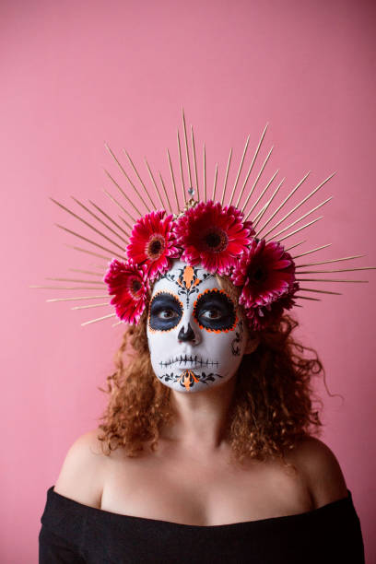
01.
MERCURY
You can enter a subtitle here
Notes:
slidesppt.net

Slide 6
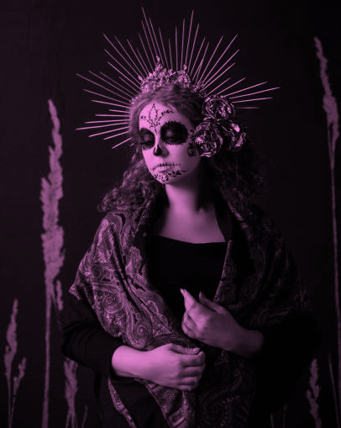
THE SLIDE TITLE GOES HERE!
Do you know what helps you make your point clear? Lists like this one:
They’re simple
You can organize your ideas clearly
You’ll never forget to buy milk!
And the most important thing: the audience won’t miss the point of your presentation

Slide 7
DIVIDE THE CONTENT
MERCURY
VENUS
Mercury is the closest planet to the Sun and the smallest one in the Solar System
Venus has a beautiful name and is the second planet from the Sun. It’s terribly hot
Notes:
slidesppt.net

Slide 8
YOU COULD USE THREE COLUMNS
MARS
JUPITER
SATURN
Despite being red, Mars is a cold place
It’s a gas giant and the biggest planet
It’s composed mostly of hydrogen and helium

Slide 9
A PICTURE ALWAYS REINFORCES THE CONCEPT
Images reveal large amounts of data, so remember: use an image instead of long texts
Notes:
slidesppt.net

Slide 10
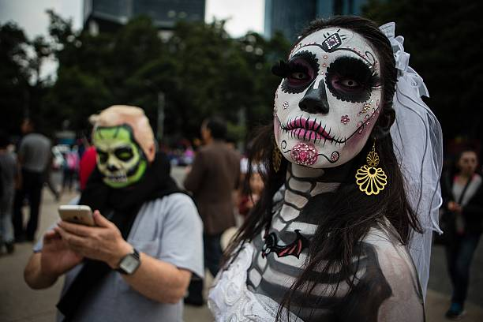
02
SECTION
You can enter a subtitle here

Slide 11
A PICTURE IS WORTH A THOUSAND WORDS
Notes:
slidesppt.net

Slide 12
REVIEWING CONCEPTS IS A GOOD IDEA
MERCURY
VENUS
MARS
It’s the closest planet to the Sun
Venus has a beautiful name
Despite being red, it’s a cold place
JUPITER
SATURN
NEPTUNE
It’s the biggest planet of them all
It’s the ringed one and a gas giant
It’s the farthest one from the Sun

Slide 13
FOUR COLUMNS
MERCURY
MARS
VENUS
SATURN
Smallest and closest planet to the Sun
Despite being red, Mars is cold
Venus has a beautiful name, but is very hot
It’s the ringed one and a gas giant
Notes:
slidesppt.net

Slide 14
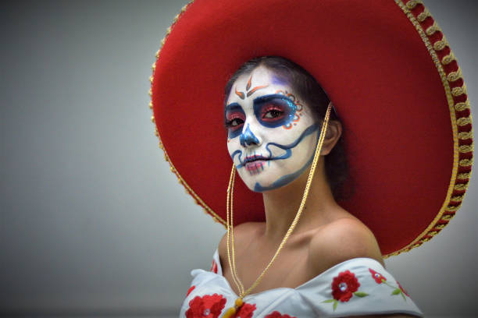
TWO COLUMNS
MERCURY
Closest planet to the Sun
Smallest one in the Solar System
JUPITER
A gas giant
Biggest planet in the Solar System

Slide 15
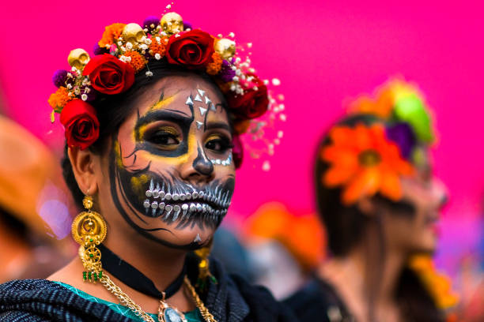
AWESOME WORDS
Notes:
slidesppt.net

Slide 16
333,000
24h 37m
386,000 km
Earths is the Sun’s mass
Is Jupiter’s rotation period
Between Earth and the Moon

Slide 17
A TIMELINE WORKS FINE
DAY 1
DAY 3
Mercury is the closest planet to the Sun
Jupiter is the biggest planet of them all
DAY 2
DAY 4
Despite being red, Mars is a cold place
Venus has a beautiful name, but it’s very hot
Notes:
slidesppt.net

Slide 18
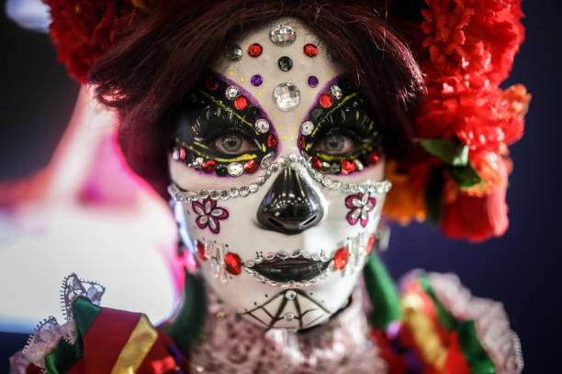
4,498,300,000
Big numbers catch your audience’s attention

Slide 19
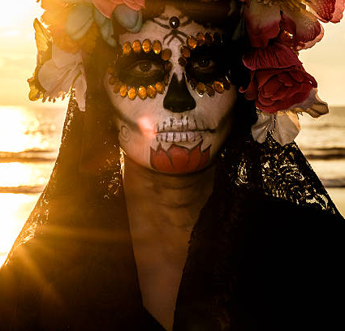
WHOA!
This can be the part of the presentation where you introduce yourself, write your email…
Notes:
slidesppt.net

Slide 20
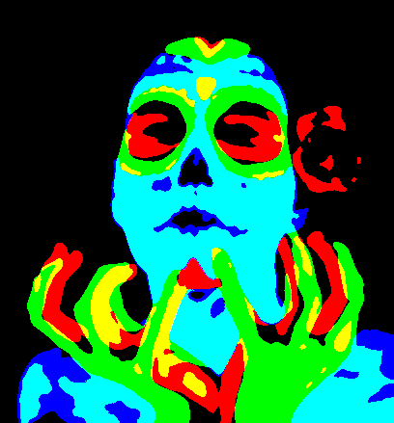
OUR TEAM
SUSAN DOE
JEFF SMITHS
You can replace the image on the screen with your own one
You can replace the image on the screen with your own one

Slide 21
01
02
CONCLUSIONS
03
Despite being red, Mars is a very cold place in the Solar System, not hot
Venus has a beautiful name and is the second planet from the Sun
Jupiter is a giant and the biggest planet in the Solar System
Notes:
slidesppt.net

Slide 22
BIG ENDING WORDS

Slide 23
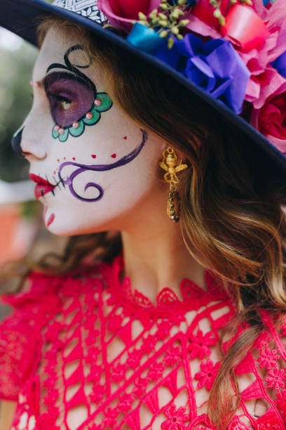
THANKS
Do you have any questions?
Please keep this slide for attribution
Notes:
slidesppt.net

Slide 24
FUENTE
ELABORADO POR : slidesppt.net
IMAGES :
gettyimages.es
FONTS :
Londrina Solid
Manjari
slidesppt.net
Notes:
slidesppt.net

Slide 25
RESOURCES
Notes:
slidesppt.net

Slide 26
Fully Editable Icon Sets: A
Notes:
slidesppt.net

Slide 27
Fully Editable Icon Sets: B
Notes:
slidesppt.net

Slide 28
Fully Editable Icon Sets: C
Notes:
slidesppt.net

