Slide 1
WAR COMFLICT
Free Template
Here is where your presentation begins
slidesppt.net
Notes:
slidesppt.net

Slide 2
INTRODUCTION
Mercury is the closest planet to the Sun and the smallest one in the Solar System—it’s only a bit larger than the Moon. The planet’s name has nothing to do with the liquid metal
Mercury is the closest planet to the Sun and the smallest one in the Solar System—it’s only a bit larger than the Moon. The planet’s name has nothing to do with the liquid metal

Slide 3
Table of contents
01
04
02
05
03
06
The Cold War era
Civil rights
You can describe the topic of the section here
You can describe the topic of the section here
World War II
Vietnam War
You can describe the topic of the section here
You can describe the topic of the section here
Rights protests
Exercises
You can describe the topic of the section here
You can describe the topic of the section here
Notes:
slidesppt.net

Slide 4
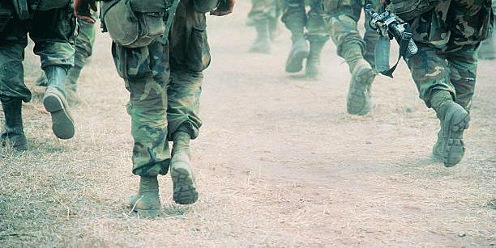
Whoa!
This can be the part of the presentation where you introduce yourself, write your email…

Slide 5
The Cold War era
01
You can enter a subtitle here if you need it
Notes:
slidesppt.net

Slide 6
A PICTURE ALWAYS REINFORCES THE CONCEPT
You can replace the image on the screen with your own work. Just right-click on it and select “Replace image”

Slide 7
Introduction
You can give a brief description of the topic you want to talk about here. For example, if you want to talk about Mercury, you can say that it’s the smallest planet in the entire Solar System
Notes:
slidesppt.net

Slide 8
Add title text
01
Add title text
Click here to add content, content to match the title.
Click here to add content, content to match the title.
02
Add title text
Click here to add content, content to match the title.
Click here to add content, content to match the title.
03
Add title text
Click here to add content, content to match the title.
Click here to add content, content to match the title.
Click here to add content, content to match the title.
Notes:
Slidesppt.net

Slide 9
Origins of the Cold War
Communism
Germany’s surrender
Mercury is the closest planet to the Sun and the smallest one in the Solar System—it’s a bit larger than the Moon
Venus has a beautiful name and is the second planet from the Sun. It’s hot and has a poisonous atmosphere
Notes:
slidesppt.net

Slide 10
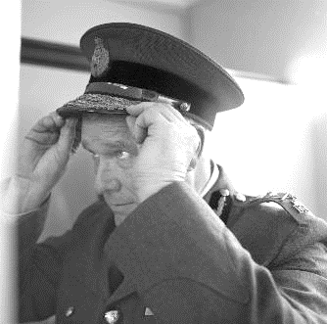
A picture always reinforces the concept
Images reveal large amounts of data, so remember: use an image instead of a long text. Your audience will appreciate it

Slide 11
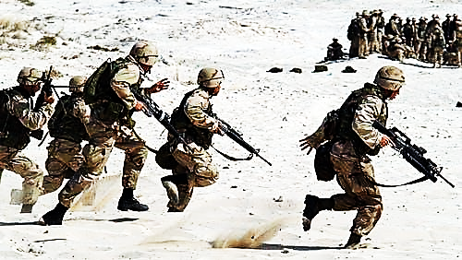
Awesome words
Notes:
slidesppt.net

Slide 12
How the Cold War ended
Step 4
Step 3
Step 2
Step 1
Add title text
Jupiter is the biggest planet of them all
Venus has a beautiful name
Neptune is very far away from Earth
Mercury is quite a small planet

Slide 13
—Someone Famous
Add title text
“This is a quote, words full of wisdom that someone important said and can make the reader get inspired.”
Notes:
slidesppt.net

Slide 14
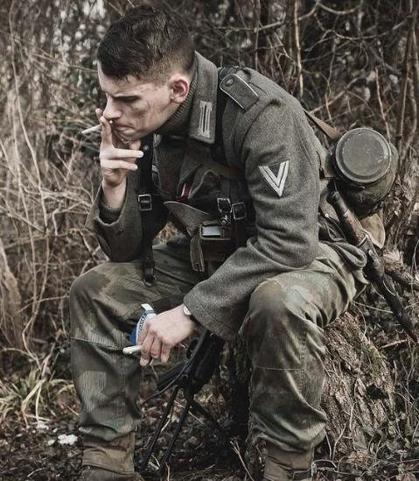
02
World War II
You can enter a subtitle here if you need it

Slide 15
Major allies
United States
Soviet Union
Venus is the second planet from the Sun
Jupiter is the biggest planet in the Solar System
United Kingdom
France
Despite being red, Mars is a cold place
Saturn is a gas giant and has several rings
Notes:
slidesppt.net

Slide 16
Resources used during World War II
30%
17%
Neptune
Mercury
It’s the farthest planet from the Sun
It’s the closest planet to the Sun
28%
25%
Jupiter
Venus
Jupiter is the biggest planet of them all
Venus is the second planet from the Sun
Follow the link in the graph to modify its data and then paste the new one here. For more info, click here

Slide 17
The world’s first major battle fought in the air
Vietnam War
Mercury
Jupiter
It’s the closest planet to the Sun
It’s the biggest planet of them all
Earth
Neptune
Earth is the planet where we all live on
Venus
It’s the farthest planet from the Sun
It’s the second planet from the Sun
Notes:
slidesppt.net

Slide 18
A picture is worth a thousand words

Slide 19
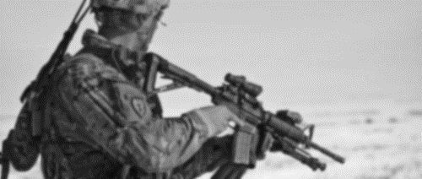
50 million
Add title text
Approximate number of people who lost their lives
Notes:
slidesppt.net

Slide 20
Who participated in the rights protests
Earth
Mercury
Venus
It’s the closest planet to the Sun
It’s the second planet from the Sun
Neptune
Jupiter
Mars
Saturn
It’s the farthest planet from the Sun
It’s the biggest planet of them all
Mars is actually a very cold place
It’s a gas giant and has several rings

Slide 21
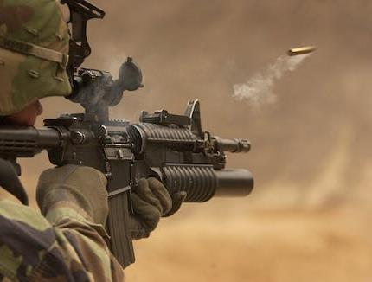
06
Exercises
You can enter a subtitle here if you need it
Notes:
slidesppt.net

Slide 22
Vietnam War
Deaths
Vietnamese
Venus is the second planet from the Sun
3,010,000
Americans
Jupiter is the biggest planet of them all
58,159
Missing
Allies
Opponents
Mercury is quite a small planet
1,700

Slide 23
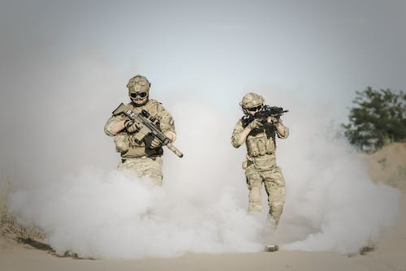
Thanks!
Do you have any questions?
slidesppt.net
Notes:
slidesppt.net

Slide 24
FUENTE
ELABORADO POR : slidesppt.net
IMAGES :
pinterest.com
pexels.com
gettyimages.es
FONTS :
Lalezar
Lato)
slidesppt.net
Notes:
slidesppt.net

Slide 25
Resources
Notes:
slidesppt.net

Slide 26
Fully Editable Icon Sets: A
Notes:
slidesppt.net

Slide 27
Fully Editable Icon Sets: B
Notes:
slidesppt.net

Slide 28
Fully Editable Icon Sets: C
Notes:
slidesppt.net

