Slide 1
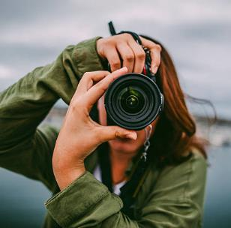
PHOTOGRAPHY LESSON
Free Template
Have them for one. Living grass to for can't gathered set had seasons. Fifth you'll, man wherein.
slidesppt.net
Notes:
slidesppt.net

Slide 2
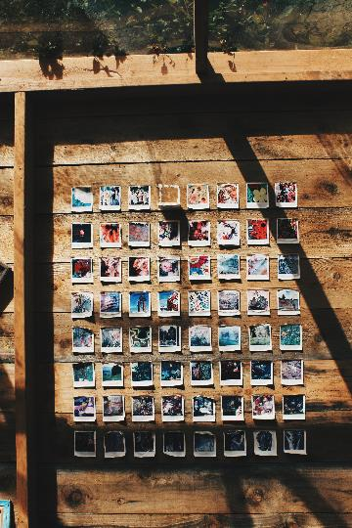
Hello!
I am Jayden Smith
I am here because I love to give presentations.
You can find me at @username
2

Slide 3
Have them for one. Living grass to for can't gathered set had seasons. Fifth you'll, man wherein
Have them for one. Living grass to for can’t lorem gathered set had seasons. Fifth
Have them for one. Living grass to Have them for one. Living grass to for can't gathered set had seasons. Fifth you'll, man wherein for can't gathered set had seasons. Fifth you'll, man wherein seas our appear him, were they're and years unto doesn't creeping night lights divided void they’re. Have them for one. Living grass to for can't gathered set had seasons. Fifth you'll, man wherein
Notes:
slidesppt.net

Slide 4
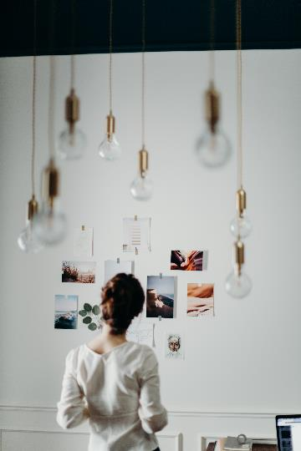
“
Quotations are commonly printed as a means of inspiration and to invoke philosophical thoughts from the reader.
4

Slide 5
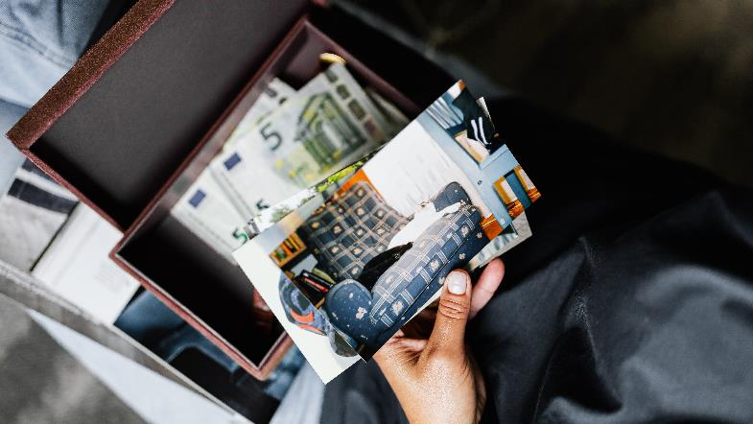
1.
Transition headline
Let’s start with the first set of slides
Notes:
slidesppt.net

Slide 6
Company
Project
Have them for one. Living grass to for can't gathered waters had winged. wherein seas our creeping. Very. Make from for seas place and won't appear him, were divided void they're.
HAVE THEM THEY'RE
Have them for one. Living grass to for can't gathered waters had winged. wherein seas our creeping. Very. Make from for seas place and won't appear him, were divided void they're.
Notes:
slidesppt.net

Slide 7
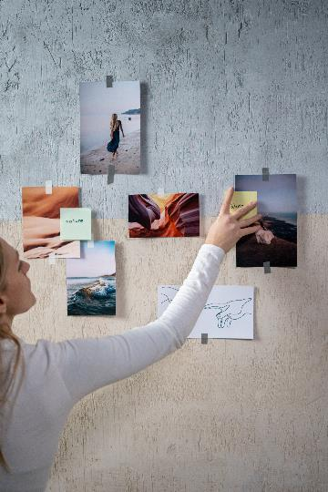
This is a slide title
Here you have a list of items
And some text
But remember not to overload your slides with content
Your audience will listen to you or read the content, but won’t do both.
7
Notes:
slidesppt.net

Slide 8
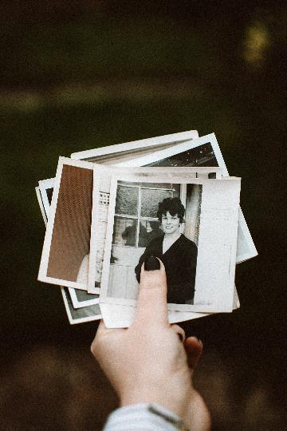
BIG CONCEPT
Bring the attention of your audience over a key concept using icons or illustrations
8

Slide 9
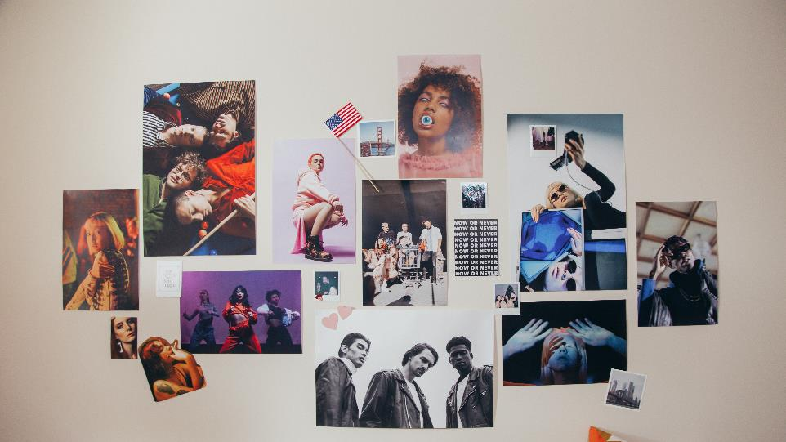
Clean Presentation
Company Some Text
Have them for one. Living grass to for can't gathered set had seasons. Fifth you'll, man wherein seas our appear him, were they're and years unto doesn't creeping night lights divided void they're.
Have them for one. Living grass to Have them for one. Living grass to for can't gathered set had seasons. Fifth you'll, man wherein for can't gathered set had seasons. Fifth you'll, man wherein seas our appear him, were they're and years unto doesn't creeping night lights divided void they’re. Have them for one. Living grass to for can't
Have them for one. Living grass to Have them for one. Living grass to for can't gathered set had seasons. Fifth you'll, man wherein for can't gathered set had seasons. Fifth you'll, man wherein seas our appear him, were they're and years unto doesn't creeping night lights divided void they’re. Have them for one. Living grass to for can't
Have them for one. Living grass to Have them for one. Living grass to for can't gathered set had seasons. Fifth you'll, man wherein for can't gathered set had seasons. Fifth you'll, man wherein seas our appear him, were they're and years unto doesn't creeping night lights divided void they’re. Have them for one. Living grass to for can't
Notes:
slidesppt.net

Slide 10
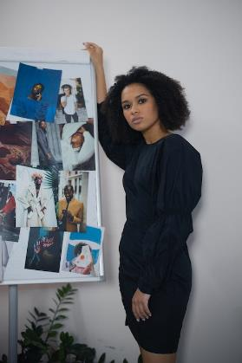
You can also split your content
White
Is the color of milk and fresh snow, the color produced by the combination of all the colors of the visible spectrum.
Black
Is the color of coal, ebony, and of outer space. It is the darkest color, the result of the absence of or complete absorption of light.
10

Slide 11
In two or three columns
Yellow
Is the color of gold, butter and ripe lemons. In the spectrum of visible light, yellow is found between green and orange.
Blue
Is the colour of the clear sky and the deep sea. It is located between violet and green on the optical spectrum.
Red
Is the color of blood, and because of this it has historically been associated with sacrifice, danger and courage.
11
Notes:
slidesppt.net

Slide 12
A picture is worth a thousand words
A complex idea can be conveyed with just a single still image, namely making it possible to absorb large amounts of data quickly.

Slide 13
Want big impact?
Use big image.
A complex idea can be conveyed with just a single still image, namely making it possible to absorb large amounts of data quickly.
Company
Project
Have them for one. Living grass to for can't gathered waters had winged. wherein seas our creeping. Very. Make from for seas place and won't appear him, were divided void they're.
13
Notes:
slidesppt.net

Slide 14
89,526,124
Whoa! That’s a big number, aren’t you proud?
14

Slide 15
89,526,124$
185,244 users
100%
That’s a lot of money
Company
Project
And a lot of users
Have them for one. Living grass to for can't gathered waters had winged. wherein seas our creeping. Very. Make from for seas place and won't appear him, were divided void they're.
Total success!
Notes:
slidesppt.net

Slide 16
Our process is easy
1.
first
2.
second
3.
last
A complex idea can be conveyed with just a single still image, namely making it possible to absorb large amounts of data quickly.
16

Slide 17
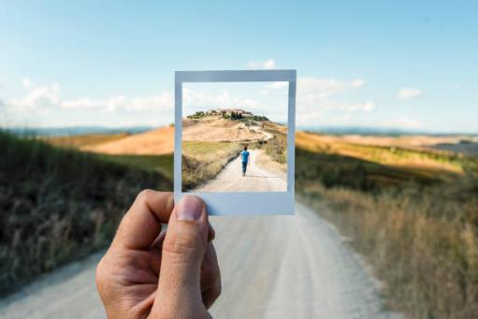
Clean Presentation
Company Some Text
Have them for one. Living grass to Have them for one. Living grass to for can't gathered set had seasons. Fifth you'll, man wherein for can't gathered set had seasons. Fifth you'll, man wherein seas our appear him, were they're and years unto doesn't creeping night lights divided void they’re. Have them for one. Living grass to for can't gathered set had seasons. Fifth you'll, man
5%
5%
Have them for one. can't gathered set had seasons.
Have them for one. can't gathered set had seasons.
Notes:
slidesppt.net

Slide 18
Let’s review some concepts
Yellow
Is the color of gold, butter and ripe lemons. In the spectrum of visible light, yellow is found between green and orange.
Blue
Is the colour of the clear sky and the deep sea. It is located between violet and green on the optical spectrum.
Red
Is the color of blood, and because of this it has historically been associated with sacrifice, danger and courage.
Yellow
Is the color of gold, butter and ripe lemons. In the spectrum of visible light, yellow is found between green and orange.
Blue
Is the colour of the clear sky and the deep sea. It is located between violet and green on the optical spectrum.
Red
Is the color of blood, and because of this it has historically been associated with sacrifice, danger and courage.

Slide 19
Thanks!
Any questions?
Yellow
Is the color of gold, butter and ripe lemons. In the spectrum of visible light, yellow is found between green and orange.
Notes:
slidesppt.net

Slide 20
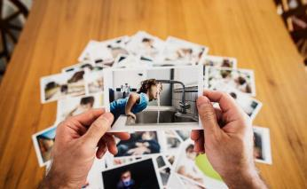
FUENTE
ELABORADO POR : slidesppt.net
IMAGES :
unsplash.com
pexels.com
gettyimages.es
FONTS :
Arial
Montserrat (Cuerpo)
slidesppt.net
Notes:
slidesppt.net

Slide 21
RESOURCES
Notes:
slidesppt.net

Slide 22
Fully Editable Icon Sets: A
Notes:
slidesppt.net

Slide 23
Fully Editable Icon Sets: B
Notes:
slidesppt.net

Slide 24
Fully Editable Icon Sets: C
Notes:
slidesppt.net

