Slide 1
Animated
POLARIS
Free Template
Here is where your presentation begins
slidesppt.net
Notes:
slidesppt.net

Slide 2
01
Click to replace the text
03
Click to replace the text
02
Click to replace the text
04
Click to replace the text
CONTENTS

Slide 3
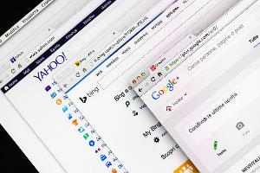
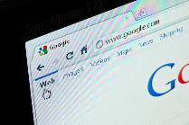
Authority
Trust
Relevance
Venus has a
beautiful name,
but it’s terribly hot
Neptune is the farthest planet from the Sun
Jupiter is the biggest planet and a gas giant
Notes:
slidesppt.net

Slide 4
01
Click here to replace the text
Click here to replace text Click here to replace text Click here to replace text Click here to replace text

Slide 5
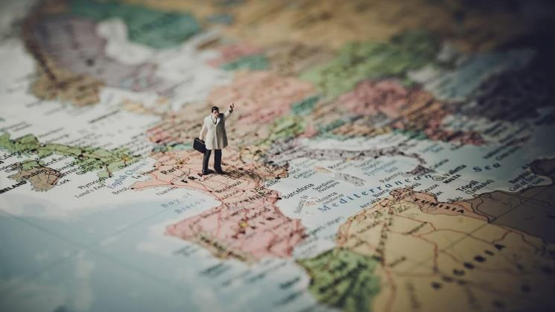
Click to replace the text
Click here to replace text Click here to replace text Click here to replace text Click here to replace text Click here to replace text
Click here to replace text Click here to replace text Click here to replace text Click here to replace text Click here to replace text
Free Template
Here is where your presentation begins
Notes:
slidesppt.net

Slide 6
Free Template
Here is where your presentation begins
Replace the text
Replace the text
Click here to replace text Click here to replace text Click here to replace text Click here to replace text
Click here to replace text Click here to replace text Click here to replace text Click here to replace text
Replace the text
Replace the text
Click here to replace text Click here to replace text Click here to replace text Click here to replace text
Click here to replace text Click here to replace text Click here to replace text Click here to replace text

Slide 7
Text tittle
Click here to replace the text Click here to replace the text Click here to replace the text
Notes:
slidesppt.net

Slide 8
Keywords
Mercury is the closest planet to the Sun and the smallest one in the Solar System
Mercury is the closest planet to the Sun and the smallest one in the Solar System
Mercury is the closest planet to the Sun and the smallest one in the Solar System
Notes:
slidesppt.net

Slide 9
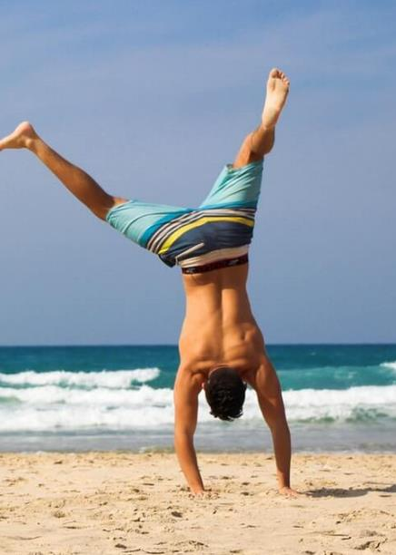
Click to replace the text
Click here to replace text Click here to replace text Click here to replace text Click here to replace text Click here to replace text Click here to replace text
Notes:
slidesppt.net

Slide 10
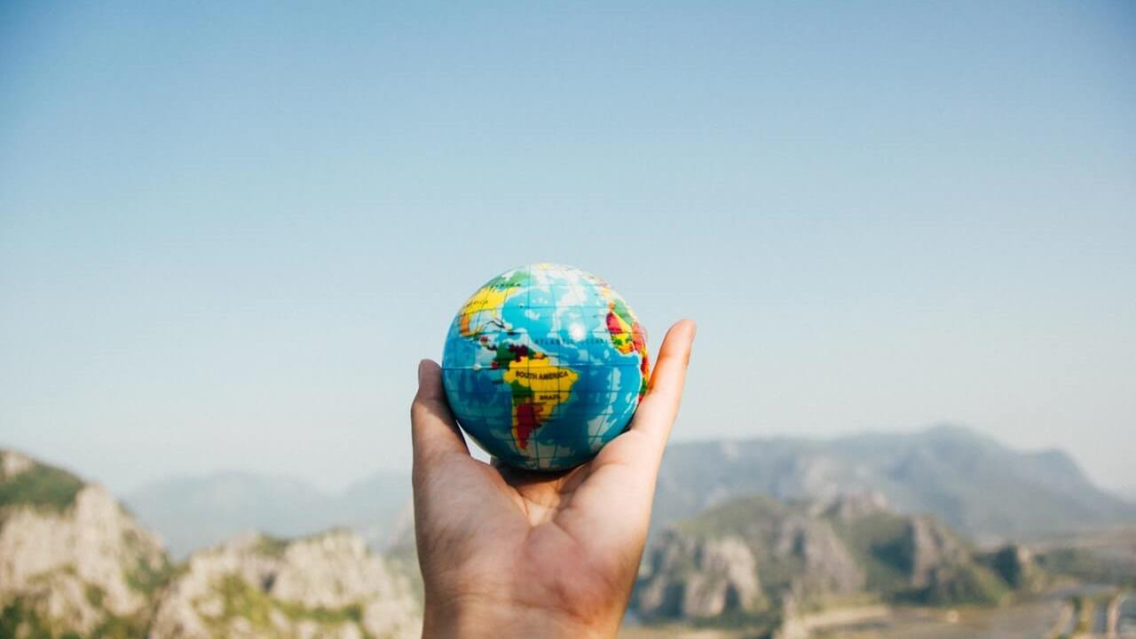
02
Click here to replace the text
Click here to replace text Click here to replace text Click here to replace text Click here to replace text

Slide 11
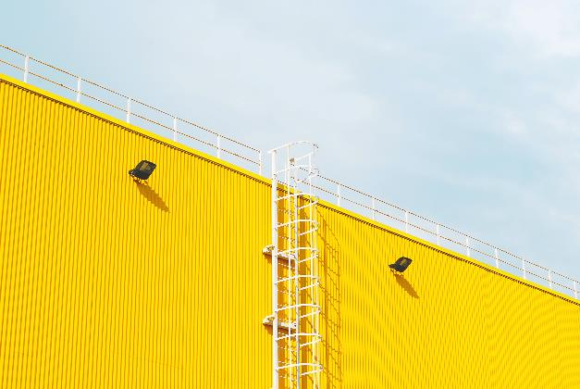
Awesome
Words
Mercury is the closest planet to
the Sun and the smallest one in the Solar System—it’s only a bit larger than the Moon
Mercury is the closest planet to
the Sun and the smallest one in the Solar System—it’s only a bit larger than the Moon
Notes:
slidesppt.net

Slide 12
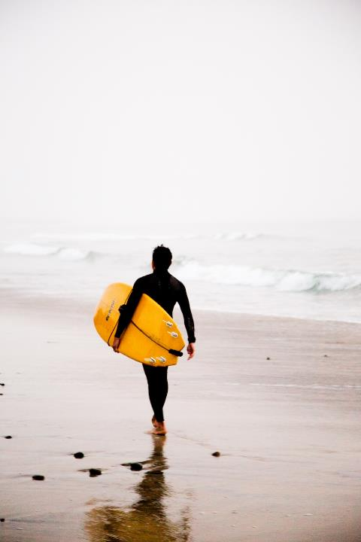
Trust
MARS
VENUS
JUPITER
To modify this graph, click on it, follow the link, change the data and paste the new graph here
Notes:
slidesppt.net

Slide 13
replace the text
Click here and change the words
Click here to replace text Click here to replace text Click here to replace text Click here to replace text Click here to replace text Click here to replace text Click here to replace text Click here to replace text click here to replace text

Slide 14
Replace the text
Click here to replace text Click here to replace text Click here to replace text Click here to replace text
Notes:
slidesppt.net

Slide 15
Replace the text
Click here to replace the text Click here to replace the text Click here to replace the text
Replace the text
Click here to replace the text Click here to replace the text Click here to replace the text
Replace the text
Click here to replace the text Click here to replace the text Click here to replace the text

Slide 16
03
Click here to replace the text
Notes:
slidesppt.net

Slide 17
Replace the text
Replace the text
Replace the text
Click here to replace the text Click here to replace the text Click here to replace the text
Click here to replace the text Click here to replace the text Click here to replace the text
Click here to replace the text Click here to replace the text Click here to replace the text

Slide 18
04
Click here to replace the text
Do you have any questions?
Mercury is the closest planet to the Sun and the smallest one in the Solar System
Notes:
slidesppt.net

Slide 19
Every time you go forward
A cleansing of the heart
Replace the text
Click here to replace text Click here to replace text Click here to replace text Click here to replace text

Slide 20
SERPs
Mercury is the closest planet to
the Sun and the smallest one in the Solar System—it’s only a bit larger than the Moon
Notes:
slidesppt.net

Slide 21
Sitemap
MARS
VENUS
Despite being red, Mars is very cold
Venus has a beautiful name
MERCURY
SATURN
Mercury is very close to the Sun
Saturn is a gas
giant planet

Slide 22
Increase Website Traffic
Mercury is the closest planet to
the Sun and the smallest one in the Solar System—it’s only a bit larger than the Moon
VENUS
JUPITER
SATURN
NEPTUNE
MARS
MERCURY

Slide 23
Market
Analysis
02
You can enter a subtitle here in case you need it
Notes:
slidesppt.net

Slide 24
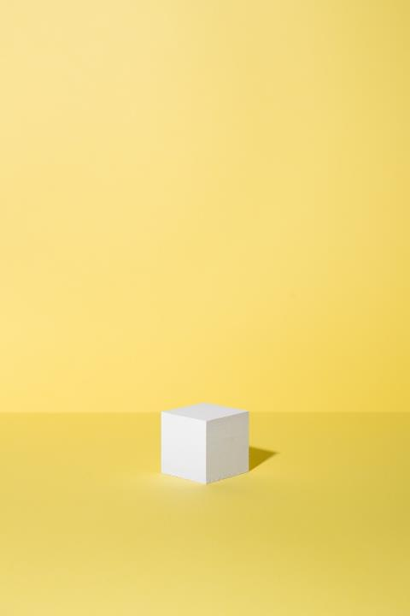
Replace the text
Click here to replace text Click here to replace text Click here to replace text Click here to replace text
Every time you go forward
A cleansing of the heart

Slide 25
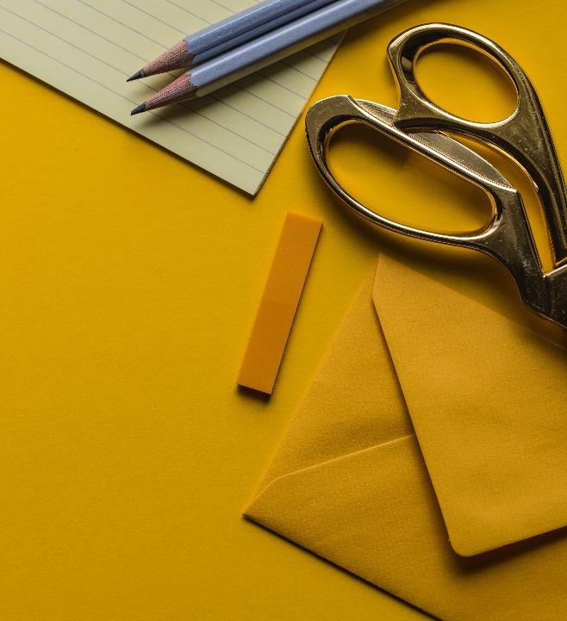
Thanks
Do you have any questions?
Mercury is the closest planet to the Sun and the smallest one in the Solar System
slidesppt.net
Notes:
slidesppt.net

Slide 26
FUENTE
ELABORADO POR : slidesppt.net
IMAGES :
gettyimages.es
pexels.com
FONTS :
Arial
Microsoft YaHei (Títulos)
微软雅黑 Light (Cuerpo)
slidesppt.net
Notes:
slidesppt.net

Slide 27
Resources
Notes:
slidesppt.net

Slide 28
Fully Editable Icon Sets: A
Notes:
slidesppt.net

Slide 29
Fully Editable Icon Sets: B
Notes:
slidesppt.net

Slide 30
Fully Editable Icon Sets: C
Notes:
slidesppt.net

