Slide 1
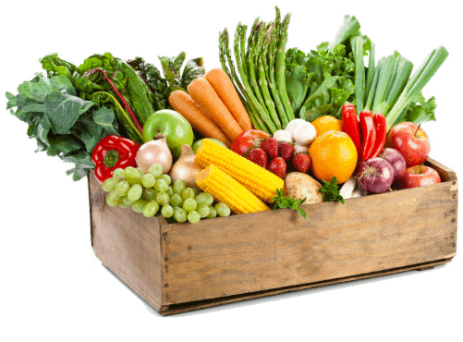
HARVEST
HARVEST
Free Template
As the company methods and ideas may not adapt to the changing internal and external environment.
slidesppt.net
Notes:
slidesppt.net

Slide 2
AGENDA
Get a modern PowerPoint Presentation that is beautifully designed.
Get a modern PowerPoint Presentation that is beautifully designed.
Get a modern PowerPoint Presentation that is beautifully designed.
Get a modern PowerPoint Presentation that is beautifully designed.

Slide 3
Infographic Style
2017
2019
2021
Your Content Here
Your Content Here
Your Content Here
2018
2020
2022
Your Content Here
Your Content Here
Your Content Here
Notes:
slidesppt.net

Slide 4
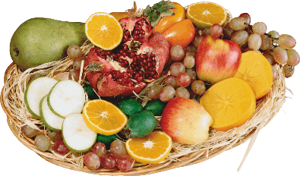
Infographic Style
Presentation Layout Clean Text Slide for your Presentation. Presentation Layout Clean Text Slide for your Presentation.
Presentation Layout Clean Text Slide for your Presentation. Presentation Layout Clean Text Slide for your Presentation.
Add Contents Title
Get a modern PowerPoint Presentation that is beautifully designed. I hope and I believe that this Template will your Time, Money and Reputation. Easy to change colors, photos and Text. You can simply impress your audience.
Add Contents Title
Get a modern PowerPoint Presentation that is beautifully designed. I hope and I believe that this Template will your Time, Money and Reputation. Easy to change colors, photos and Text. You can simply impress your audience.
Add Contents Title
Get a modern PowerPoint
Get a modern PowerPoint
Get a modern PowerPoint
Get a modern PowerPoint

Slide 5
Modern PowerPoint Presentation
NO.1 Presentation
We Create
Quality Professional
PPT Presentation
Get a modern PowerPoint Presentation that is beautifully designed. You can simply impress your audience and add a unique zing and appeal to your Presentations. Easy to change colors, photos and Text.
MODERN
POWERPOINT
PRESENTATION
Notes:
slidesppt.net

Slide 6
table of
Contents
CONTENTS
01
Project Introduction
02
Market analysis
Risk analysis and countermeasures
03
04
financial analysis
05
Company development strategy

Slide 7
01
Project Introduction
Project Description
Venues and facilities
products and services
Company Structure
Notes:
slidesppt.net

Slide 8
Project Description
Yipinxuan Restaurant Leisure Chain Project
Yipinxuan Co., Ltd. is a proposed comprehensive service company integrating catering, leisure and entertainment. Designed to provide young people with a place to eat and entertain, whether they are “optimist” or “serious”, whether they like to be in a busy crowd or like to sit in a quiet corner, they can find Your own happiness! We hope that Yu Pin Xuan will become a gathering place for young people to drive away fatigue and relax in their work and study.
food
Provide a range of healthy, stylish drinks and foods that meet the consumption habits and needs of young people.
Leisure
Organize a variety of fun games, leisure and entertainment activities to help customers relieve stress and rest.
Social
Conduct face-to-face social activities to make up for the lack of social socialism caused by social networking, and enhance the ability to express and communicate.

Slide 9
Site selection and site
Convenient transportation
Traffic must not be too remote and must be convenient. Buses and subways should be conveniently located, and parking spaces near the storefront are better.
environmental issue
The surrounding environment should not be too noisy, the streets are clean and hygienic, the environment is beautiful, and the surrounding cinemas, Internet cafes and other supporting facilities should be as perfect as possible.
Close to the customer
According to the positioning of the target customer group, choose the principle of proximity, try to choose the place where young people gather and love to go.
Notes:
slidesppt.net

Slide 10
PRODUCTS AND SERVICES
service1
Diverse dining
A variety of stylish, stylish food and drinks are available. These include a variety of specialty foods and beverages that are representative of local and domestic and foreign countries. At the same time, provide reservation services for members.
DIY service
service2
Customers can choose their own materials and make their own drinks and foods, such as fruits, salads, cakes, chocolates, etc. They can also make small ornaments by themselves, and the small jewelry made by customers can be sold in the store. Members can order raw materials for making food, drinks, and trinkets.
service3
Talk service
Hire professional psychological counselors to carry out various kinds of confession activities, so that customers' true feelings can be fully confided in an elegant and quiet atmosphere, relieve psychological pressure, adjust psychological state, and make customers easily face work and study.

Slide 11
02
Market analysis
business background
Targeted market
competition analysis
Notes:
slidesppt.net

Slide 12
business background
01
Change in consumption outlook
Consumption development trend
With the improvement of people's living standards, the demand for catering and consumption has gradually escalated, and consumer demand has been strong, thus forming a leisure catering industry combining leisure and catering.
This part of the content as a text typesetting placeholder display
Local market
02
The city has a large development space
There are about 5,000 catering enterprises in the city, most of which are limited to pure catering operations. There are few leisure catering enterprises integrating catering, leisure and relaxation.
This part of the content as a text typesetting placeholder display
Rapid development of the industry
03
Industry background
In recent years, China's catering industry has developed rapidly. The year-on-year growth rate exceeded 15%; the Ministry of Commerce data showed that it will maintain a growth rate of 16% in the next five years.
This part of the content as a text typesetting placeholder display

Slide 13
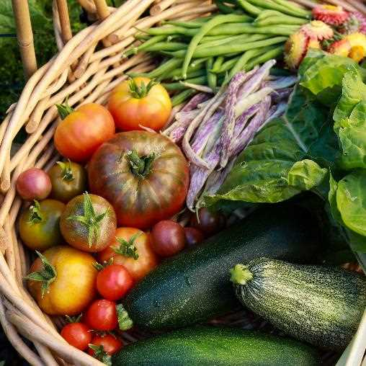
competition analysis
After researching the location of the company’s three stores, we developed a competitive strategy.
Operating characteristics
A leisure catering business model that integrates catering, leisure and entertainment;
Stylish cuisine developed for young people;
Musical space, psychological counseling and other special services;
Pay attention to process experience such as environmental sanitation;
A preferential pricing strategy for students.
Mostly a single product and service
The environment is generally even worse
Service homogenization is more serious
Notes:
slidesppt.net

Slide 14
03
Risk analysis and countermeasures
Market risk and countermeasures
Financial risks and countermeasures
Management risk and countermeasures
Profit model risk and countermeasures

Slide 15
Market risk and countermeasures
risk
The company's service is recognized by the market as having a process.
The increase in potential entrants and existing competitors has led to fluctuations in the price of the company’s products, affecting profits
Competitors use malicious means of competition to affect corporate profits
市场风险
和对策
Adhere to the company management, improve service quality, reduce costs and improve overall competitiveness
Establish a sound market information network system, enhance market resilience, and enrich and evolve service types.
Seeking support from the industry chain alliance
Implement brand strategy
Countermeasures
Notes:
slidesppt.net

Slide 16
Financial risks and countermeasures
risk
In the early stage of development, the financial risks are mainly reflected in the risk of shortage of funds.
Strengthen the monitoring of the company's capital operation and maximize the use of funds;
The initial investment is mainly from the site rent, renovation costs, facilities and equipment purchase costs, and promotional expenses.
Strictly implement financial supervision and budget system;
Hire high-quality financial and management personnel for effective management.
Countermeasures
In the early stage of development, the financial risks are mainly reflected in the risk of shortage of funds.
Strictly implement financial supervision and budget system;

Slide 17
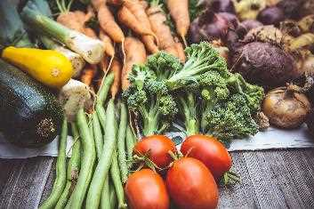
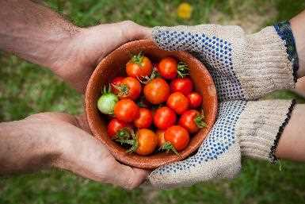
Management risk and countermeasures
Site selection and site
Management risk
As the company expands, the company's organizational structure, management methods and ideas may not adapt to the changing internal and external environment.
The products and services developed by the company's independent R&D team cannot keep up with the changes in consumer demand.
Countermeasures
Implement target cost management and strengthen cost control;
Take internal training, external training and other measures to improve the overall quality of the management team;
Advocate organizational innovation and innovative thinking to adapt to the changing external environment.
Notes:
slidesppt.net

Slide 18
04
financial analysis
Investment structure
cost calculation
Pricing Strategy
Income statement
Income forecast
Source of financing

Slide 19
Investment structure
：
Fixed assets
Tables and chairs, catering equipment, store facilities, etc., will cost about 270,000 yuan.
Rent and decoration
The rent and decoration costs of the three storefronts will cost about 340,000 yuan.
Initial operating
expenses
Initial publicity advertising, operating expenses, and network promotion fees totaled 236,000 yuan.
Liquidity
Daily working capital and staff wages total 100,000 yuan.
Notes:
slidesppt.net

Slide 20
Monthly operating expenses
Monthly operating costs
6833
9000
79200
92000
8000
Amortization fee
Utility fee
staff salary
House rental fee
Promotion fee
Total: 320,800 yuan
The designed annual operating income is about 5.316 million yuan, the fixed assets amount is 440,000 yuan, and the house rent (annual payment) is 1.104 million yuan. Fixed assets are expected to be used for 5 years, and depreciation of fixed assets is calculated using the average years method (except in July and August).
Notes:
slidesppt.net

Slide 21
Profit forecast
Total profit
236.38
Ten
thousand
yuan
Operating income
513.168
Operating
cost
Operating expenses
125.84
Ten
thousand
yuan
150.2
Ten
thousand
yuan
Ten thousand yuan
Total profit
236.38
Ten
thousand
yuan
Income
177.28
Ten
thousand
yuan
Net profit
59.93
Ten
thousand
yuan

Slide 22
05
Company development strategy
company strategy
future plan
Notes:
slidesppt.net

Slide 23
company strategy
Catering Health Diversification Strategy
Service diversity strategy
Strictly guarantee food hygiene, ensure good quality, let customers eat with confidence, eat comfortably; provide foreign food ordering service, DIYservice.
Constantly develop and introduce new activities and services to maintain the company's competitiveness.
Capital operation strategy
Cultural popularization strategy
Make the most efficient use of capital to maximize its benefits.
In the early stage of development, we widely publicized the culture of our company, enhanced the company's popularity, and established our company's position in the hearts of consumers.

Slide 24
future plan
The first phase
the second term
Third period
1
2
3
Standardized operation
Strengthen the brand
franchise management
From 2017 to 2019, we created services and processes as core competencies to form a unique corporate culture and management model.
Form the company's culture to spread widely, develop entry-level customers, and cultivate loyal consumers
Since 2019, the company has implemented an expansion policy and opened branches throughout the province, striving to make the company a major market leader in comprehensive entertainment and entertainment venues in Anhui.
Notes:
slidesppt.net

Slide 25
Thanks for listening
Enter the company/team name here

Slide 26
FUENTE
ELABORADO POR : slidesppt.net
IMAGES :
unsplash.com
pixabay.com
pngwing.com
FONTS :
Microsoft YaHei
Arial Black (Títulos)
Arial (Cuerpo)
slidesppt.net
Notes:
slidesppt.net

Slide 27
Resources
Notes:
slidesppt.net

Slide 28
Fully Editable Icon Sets: A
Notes:
slidesppt.net

Slide 29
Fully Editable Icon Sets: B
Notes:
slidesppt.net

Slide 30
Fully Editable Icon Sets: C
Notes:
slidesppt.net

