Slide 1
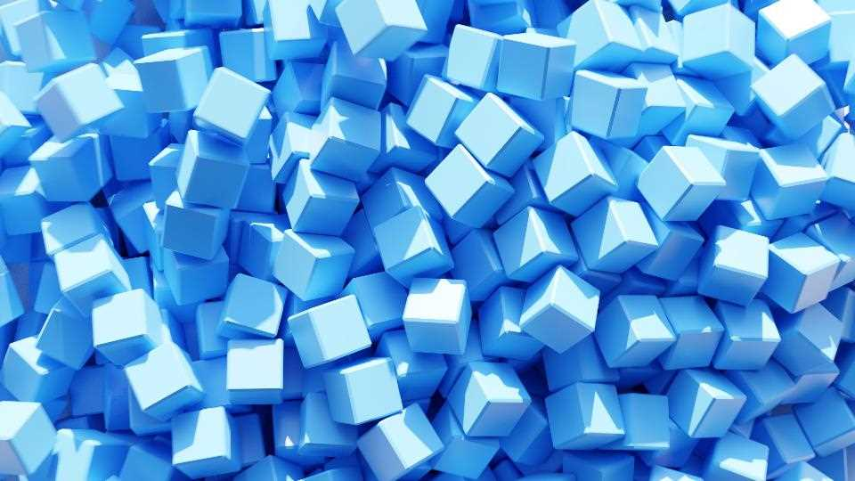
CUBES
Free Template
Here is where your infographic begins
slidesppt.net
Notes:
slidesppt.net

Slide 2
AGENDA STYLE
01
Contents
Get a modern PowerPoint Presentation that is beautifully designed. I hope and I believe that this Template will your Time.
02
Contents
Get a modern PowerPoint Presentation that is beautifully designed. I hope and I believe that this Template will your Time.
03
Contents
Get a modern PowerPoint Presentation that is beautifully designed. I hope and I believe that this Template will your Time.
04
Contents
Get a modern PowerPoint Presentation that is beautifully designed. I hope and I believe that this Template will your Time.

Slide 3
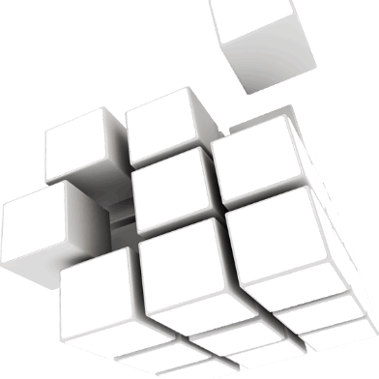
3D CUBE DIAGRAMS
30%
Venus has a beautiful name and is the second planet from the Sun
20%
Saturn is composed of hydrogen and helium and it’s the ringed one
10%
Mercury is the closest planet to the Sun and the smallest one
Notes:
slidesppt.net

Slide 4
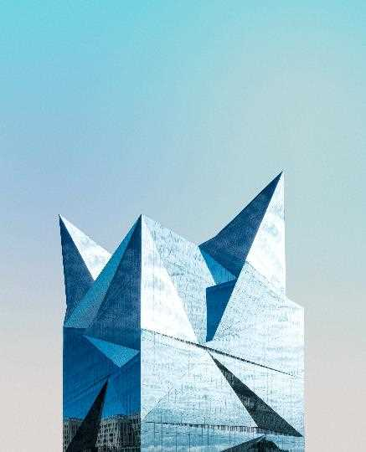
Simple PowerPoint Presentation
Get a modern PowerPoint Presentation that is beautifully designed. I hope and I believe that this Template will your Time, Money and Reputation. Easy to change colors, photos and Text.
Awesome Presentation
with

Slide 5
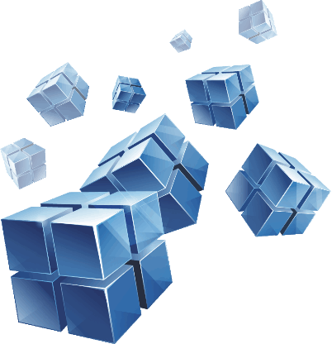
3D CUBE DIAGRAMS
MERCURY
MARS
Mercury is the closest planet to the Sun and the smallest one
Mars is actually a cold place. It’s full of iron oxide dust
SATURN
JUPITER
Saturn is composed of hydrogen and helium and is the ringed one
Jupiter is a gas giant and the biggest planet in the Solar System
VENUS
NEPTUNE
Venus has a beautiful name and is the second planet from the Sun
Neptune is the farthest planet from the Sun and the fourth-largest one
Notes:
slidesppt.net

Slide 6
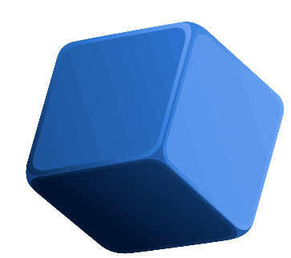
3D CUBE DIAGRAMS
MERCURY
MARS
Mercury is the closest planet to the Sun and the smallest one
Mars is actually a cold place. It’s full of iron oxide dust
SATURN
JUPITER
Saturn is composed of hydrogen and helium and is the ringed one
Jupiter is a gas giant and the biggest planet in the Solar System

Slide 7
3D CUBE DIAGRAMS
MERCURY
SATURN
JUPITER
MARS
Mercury is the closest planet to the Sun and the smallest one
Saturn is composed of hydrogen and helium and is the ringed one
Jupiter is a gas giant and the biggest planet in the Solar System
Mars is actually a cold place. It’s full of iron oxide dust
Notes:
slidesppt.net

Slide 8
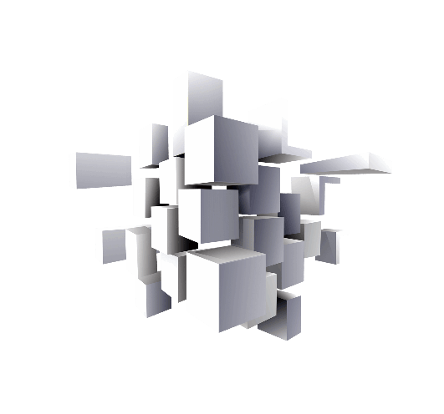
Enter a title here
MERCURY
JUPITER
Mercury is the closest planet to the Sun and the smallest one
Jupiter is a gas giant and the biggest planet in the Solar System
SATURN
MARS
Saturn is composed of hydrogen and helium and is the ringed one
Mars is actually a cold place. It’s full of iron oxide dust

Slide 9
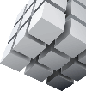
Enter a title here
Title text preset
This part of the content is displayed as a text layout placeholder (recommended to use the theme font)
Title text preset
Title text preset
This part of the content is displayed as a text layout placeholder (recommended to use the theme font)
This part of the content is displayed as a text layout placeholder (recommended to use the theme font)
Title text preset
Title text preset
This part of the content is displayed as a text layout placeholder (recommended to use the theme font)
This part of the content is displayed as a text layout placeholder (recommended to use the theme font)
Notes:
slidesppt.net

Slide 10
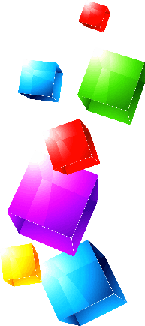
3D CUBE DIAGRAMS
VENUS
Venus has a beautiful name and is the second planet from the Sun
JUPITER
Jupiter is a gas giant and the biggest planet in the Solar System
SATURN
Saturn is composed of hydrogen and helium and it’s the ringed one
MERCURY
Mercury is the closest planet to the Sun and the smallest one
Notes:
slidesppt.net

Slide 11
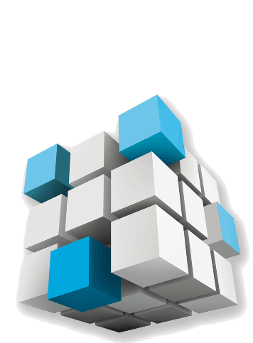
3D CUBE DIAGRAMS
MERCURY
Mercury is the closest planet to the Sun and the smallest one
JUPITER
Jupiter is a gas giant and the biggest planet in the Solar System
SATURN
Saturn is composed of hydrogen and helium and is the ringed one
Notes:
slidesppt.net

Slide 12
3D CUBE DIAGRAMS
45%
30%
Mars
Venus
Mars is actually a cold place. It’s full of iron oxide dust
Venus has a beautiful name and is the second planet from the Sun
15%
10%
Saturn
Mercury
Saturn is composed of hydrogen and helium and it’s the ringed one
Mercury is the closest planet to the Sun and the smallest one
Notes:
slidesppt.net

Slide 13
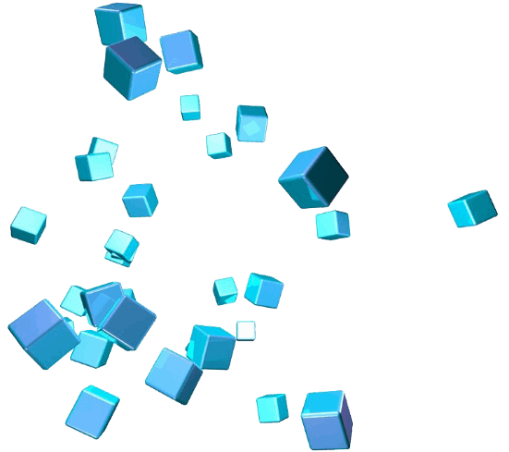
3D CUBE DIAGRAMS
01
Mars is the red planet and is actually a cold place. The surface is full of iron
02
Saturn is a massive ball made mostly of hydrogen and helium.
03
Jupiter is the massive planet .It's a stormy mass of raging gas and metallic hydrogen

Slide 14
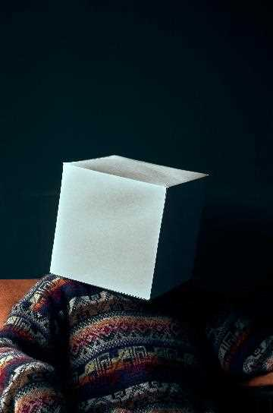
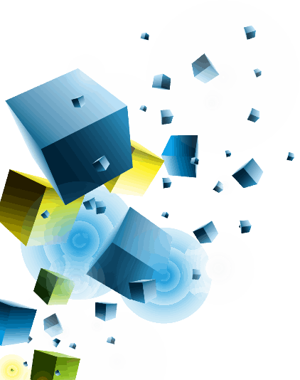
3D CUBE DIAGRAMS
JUPITER
Jupiter is a gas giant and the biggest planet in the Solar System
MERCURY
Mercury is the closest planet to the Sun and the smallest one
SATURN
Saturn is composed of hydrogen and helium and is the ringed one
Notes:
slidesppt.net

Slide 15
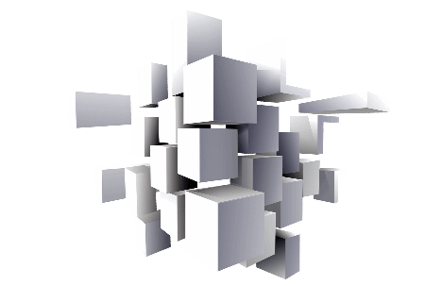
3D CUBE DIAGRAMS
VENUS
Venus has a beautiful name and is the second planet from the Sun
JUPITER
Jupiter is a gas giant and the biggest planet in the Solar System
SATURN
Saturn is composed of hydrogen and helium and it’s the ringed one
MERCURY
Mercury is the closest planet to the Sun and the smallest one

Slide 16
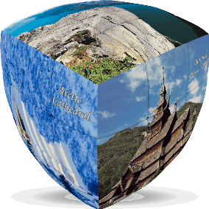
3D CUBE DIAGRAMS
10%
30%
NEPTUNE
MARS
Neptune is the farthest planet from the Sun and the fourth-largest one
Mars is the red planet and is actually a cold place
60%
40%
VENUS
JUPITER
Venus has a beautiful name and is the second planet from the Sun
Jupiter is a gas giant and the biggest planet in the Solar System
20%
50%
SATURN
MERCURY
Saturn is composed of hydrogen and helium and it’s the ringed one
Mercury is the closest planet to the Sun and the smallest one
Notes:
slidesppt.net

Slide 17
3D CUBE DIAGRAMS
B
D
A
C
SATURN
MERCURY
MARS
JUPITER
Saturn is composed of hydrogen and helium and is the ringed one
Mercury is the closest planet to the Sun and the smallest one
Mars is actually a cold place. It’s full of iron oxide dust
Jupiter is a gas giant and the biggest planet in the Solar System

Slide 18
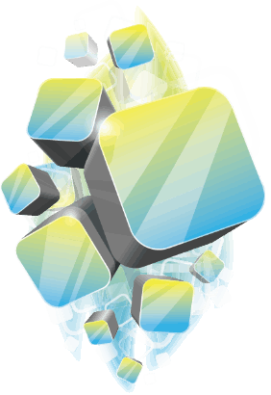
3D CUBE DIAGRAMS
VENUS
Venus has a beautiful name and is the second planet from the Sun
JUPITER
Jupiter is a gas giant and the biggest planet in the Solar System
MERCURY
Mercury is the closest planet to the Sun and the smallest one
SATURN
Saturn is composed of hydrogen and helium and it’s the ringed one
Notes:
slidesppt.net

Slide 19
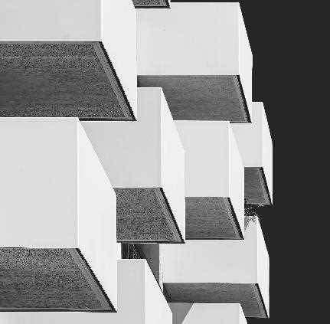
3D CUBE DIAGRAMS
127
Saturn is composed of hydrogen and helium and it’s the ringed one
234
Jupiter is a gas giant and the biggest planet in the Solar System
130
Mercury is the closest planet to the Sun and the smallest one
236
Venus has a beautiful name and is the second planet from the Sun

Slide 20
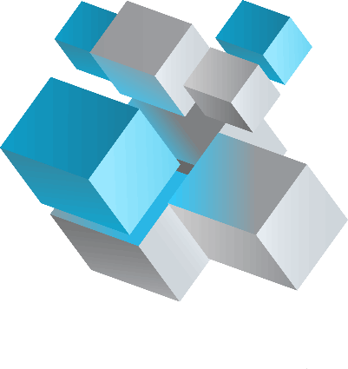
3D CUBE DIAGRAMS
VENUS
Venus has a beautiful name and is the second planet from the Sun
MERCURY
Mercury is the closest planet to the Sun and the smallest one
SATURN
Saturn is composed of hydrogen and helium and it’s the ringed one
Notes:
slidesppt.net

Slide 21
3D CUBE DIAGRAMS
VENUS
MERCURY
Venus has a beautiful name and is the second planet from the Sun
Mercury is the closest planet to the Sun and the smallest one
SATURN
JUPITER
Saturn is composed of hydrogen and helium and it’s the ringed one
Jupiter is a gas giant and the biggest planet in the Solar System

Slide 22
Modern Portfolio Presentation
PowerPoint Presentation
Get a modern PowerPoint Presentation that is beautifully designed.
You can simply impress your audience and add a unique zing and appeal to your Presentations. Easy to change colors, photos and Text. Get a modern PowerPoint Presentation that is beautifully designed. I hope and I believe that this Template will your Time, Money and Reputation. You can simply impress your audience and add a unique zing and appeal to your Presentations.
Modern PowerPoint Presentation
Notes:
slidesppt.net

Slide 23
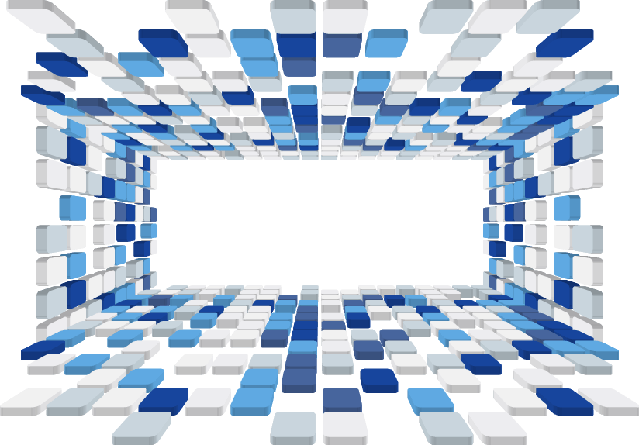
THANK YOU
This part of the content is displayed as a text layout placeholder (recommended to use the theme font)
Notes:
slidesppt.net

Slide 24
Instructions for use
In order to use this template, you must credit Slidesppt by keeping the thank you slide.
What you are allowed to do :
Use our templates for personal or educational presentations or printouts.
Edit and customize our templates for your own needs.
Link a page to a presentation template on your website or blog.
What you are not allowed to do :
Republish or redistribute our presentation templates, offline or online and even for free.
Offer Slidesppt templates (or a modified version of this Slidesppt Template) or include it in a database or any other product or service that offers downloadable images, icons or templates that may be subject to distribution or resale.
Useful links :
What you are allowed and not allowed to do: https://www.slidesppt.net/what-you-can-and-cannot-do-with-our-templates/
Frequently Asked Questions: https://www.slidesppt.net/frequently-asked-questions/
Tutorials and Tips: https://www.slidesppt.net/tutorials-and-tips/

Slide 25
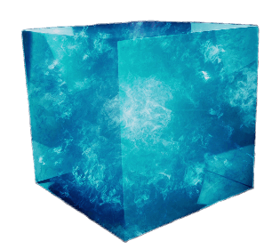
FUENTE
ELABORADO POR : slidesppt.net
IMAGES :
unsplash.com
pexels.com
pngwing.com
FONTS :
Agency FB
TT Norms Bold
Calisto MT
slidesppt.net
Notes:
slidesppt.net

Slide 26
RESOURSES
Notes:
slidesppt.net

Slide 27
Fully Editable Icon Sets: A
Notes:
slidesppt.net

Slide 28
Fully Editable Icon Sets: B
Notes:
slidesppt.net

Slide 29
Fully Editable Icon Sets: C
Notes:
slidesppt.net

Slide 30
Presentation template by
Slidesppt.net
You are free to use this presentation for educational, personal and work purposes under Creative Commons Attribution License. But, keep the credits slide or mention Slidesppt in your presentation. Visit slidesppt.net

