Slide 1
POETRY
Free Template
Here is where your
presentation begins
slidesppt.net
Notes:
slidesppt.net

Slide 2
Breck Out
This could be the part of the presentation where you can introduce yourself, write your email...

Slide 3
Free Template Now
Programmer
Programmer
You can simply impress your audience and add a unique zing.
You can simply impress your audience and add a unique zing.
Programmer
Programmer
You can simply impress your audience and add a unique zing.
You can simply impress your audience and add a unique zing.
Notes:
slidesppt.net

Slide 4
Table of Contents
03
01
04
02
Publishing
Here you could describe the topic of the section
Reading
Here you could describe the topic of the section
Teaching
Here you could describe the topic of the section
Writing
Here you could describe the topic of the section

Slide 5
Whoa!
This could be the part of the presentation where you can introduce yourself, write your email...
This could be the part of the presentation where you can introduce yourself, write your email...
Notes:
slidesppt.net

Slide 6
Introduction
Mercury is the closest planet to the Sun and the smallest one in the Solar System—it’s a bit larger than the Moon
Mercury is the closest planet to the Sun and the smallest one in the Solar System—it’s a bit larger than the Moon

Slide 7
Reading
01.
You can enter a subtitle here if you need it
Notes:
slidesppt.net

Slide 8
About World Poetry Day
Mercury is the closest planet to the Sun and the smallest one in the Solar System—it’s only a bit larger than the Moon

Slide 9
— Someone Famous
“This is a quote. Words full of wisdom that someone important said and can make the reader get inspired.”
Notes:
slidesppt.net

Slide 10
—Someone Famous
“This is a quote, words full of wisdom that someone important said and can make the reader get inspired.”

Slide 11
The Slide Title Goes Here!
Do you know what helps you make your point clear? Lists like this one:
They’re simple
You can organize your ideas clearly
You’ll never forget again to buy milk!
And the most important thing: the audience won’t miss the point
Notes:
slidesppt.net

Slide 12
We Create Quality Professional PPT Presentation
Add Contents Title
Simple Presentation
You can simply impress your audience and add a unique zing and appeal to your Presentations.
You can simply impress your audience and add a unique zing and appeal to your Presentations.
You can simply impress your audience and add a unique zing and appeal to your Presentations.
You can simply impress your audience and add a unique zing and appeal to your Presentations.
I hope and I believe that this Template will your Time, Money and Reputation. Easy to change colors, photos and text. Get a modern PowerPoint Presentation that is beautifully designed. Get a modern PowerPoint Presentation that is beautifully designed.
Portfolio
Presentation

Slide 13
A Picture Is Worth a Thousand Words
Yellow
Is the color of gold, butter and ripe lemons. In the spectrum of visible light, yellow is found between green and orange.
Yellow
Is the color of gold, butter and ripe lemons. In the spectrum of visible light, yellow is found between green and orange.
Yellow
Is the color of gold, butter and ripe lemons. In the spectrum of visible light, yellow is found between green and orange.
Notes:
slidesppt.net

Slide 14
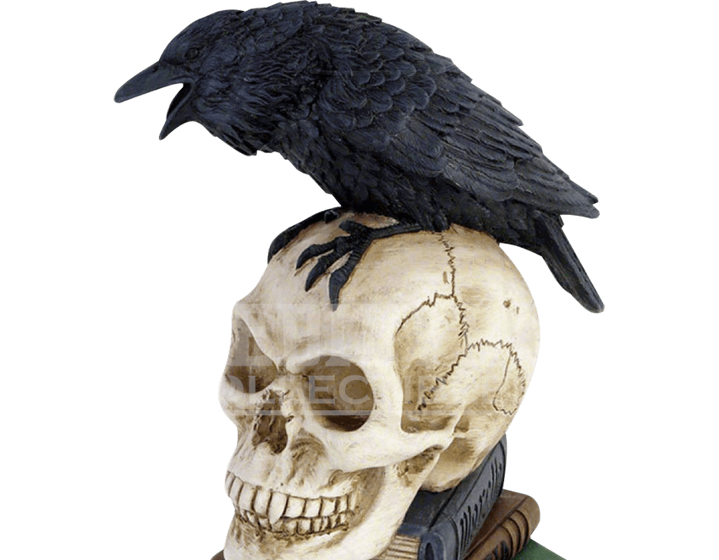
Infographics Make Your Idea Understandable...
01
02
03
Learning
Venus has a beautiful name
Reading
Jupiter is the biggest planet
Writing
Saturn is the ringed one

Slide 15
World Poetry Day Event
2020
2021
Is the color of blood, and because of this it has historically been associated with sacrifice, danger and courage.
Is the color of blood, and because of this it has historically been associated with sacrifice, danger and courage.
Is the color of blood, and because of this it has historically been associated with sacrifice, danger and courage.
Mercury is the smallest planet
Despite being red, Mars is cold
Notes:
slidesppt.net

Slide 16
A Pictures Always Reinforces the Concept
Images reveal large amounts of data, so remember: use an image instead of long texts

Slide 17
Sneak Peek
You can replace the image on the screen with your own work. Just delete this one, add yours and center it properly
You can replace the image on the screen with your own work. Just delete this one, add yours and center it properly
You can replace the image on the screen with your own work. Just delete this one, add yours and center it properly
Notes:
slidesppt.net

Slide 18
Sneak Peek
You can replace the image on the screen with your own work. Just delete this one, add yours and center it properly

Slide 19
Awesome Presentation
Timing of the Event
You can replace the image on the screen with your own work. Just delete this one, add yours and center it properly
You can replace the image on the screen with your own work. Just delete this one, add yours and center it properly
A complex idea can be conveyed with just a single still image, namely making it possible to absorb large amounts of data quickly.
A complex idea can be conveyed with just a single still image, namely making it possible to absorb large amounts of data quickly.
19
Notes:
slidesppt.net

Slide 20
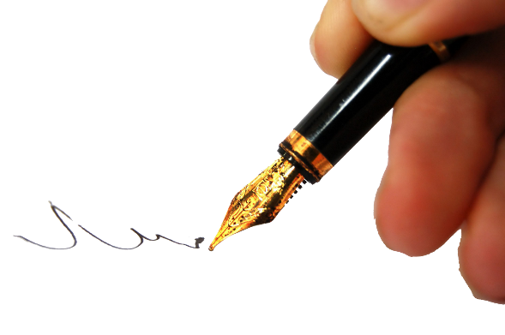
Sneak Peek
You can replace the image on the screen with your own work. Just delete this one, add yours and center it properly
You can replace the image on the screen with your own work. Just delete this one, add yours and center it properly
You can replace the image on the screen with your own work. Just delete this one, add yours and center it properly

Slide 21
Infographic Style
You can simply impress your audience and add a unique zing and appeal to your Presentations. Get a modern PowerPoint Presentation that is beautifully designed.
Content Here
Content Here
You can simply impress your audience and add a unique zing and appeal to your Presentations.
You can simply impress your audience and add a unique zing and appeal to your Presentations.
Content Here
Content Here
You can simply impress your audience and add a unique zing and appeal to your Presentations.
You can simply impress your audience and add a unique zing and appeal to your Presentations.
Notes:
slidesppt.net

Slide 22
AWESOME
PRESENTATION
EASY TO CHANGE COLORS, PHOTOS.
Get a modern PowerPoint
You can simply impress your audience and add a unique zing and appeal to your Presentations. Easy to change colors, photos and Text. Get a modern PowerPoint Presentation that is beautifully designed. You can simply impress your audience and add a unique zing and appeal to your Presentations. You can simply impress your audience and add a unique zing and appeal to your Presentations.

Slide 23
Last Year
Venus has a beautiful name
Mercury is the smallest planet
Jupiter is the biggest planet
Mars is actually a very cold place
Insert your multimedia content here
Notes:
slidesppt.net

Slide 24
Important Announcements
01
03
02
04
Venus
Mercury
Venus has a beautiful name
Mercury is the smallest planet
Jupiter
Mars
Jupiter is the biggest planet
Mars is actually a very cold place

Slide 25
How Do We Do It?
Venus
Mercury
Venus is the second planet from the Sun
Mercury is the smallest planet
Saturn
Mars
Yes, this is the ringed one. It’s a gas giant
Despite being red, Mars is cold
Notes:
slidesppt.net

Slide 26
Our Team
Jane Doe
James Patterson
Here you can talk a bit about this person. Replace the image if needed
Here you can talk a bit about this person. Replace the image if needed

Slide 27
Thanks
SLIDESPPT.NET
Notes:
slidesppt.net

Slide 28
Instructions for use
In order to use this template, you must credit Slidesppt by keeping the thank you slide.
What you are allowed to do :
Use our templates for personal or educational presentations or printouts.
Edit and customize our templates for your own needs.
Link a page to a presentation template on your website or blog.
What you are not allowed to do :
Republish or redistribute our presentation templates, offline or online and even for free.
Offer Slidesppt templates (or a modified version of this Slidesppt Template) or include it in a database or any other product or service that offers downloadable images, icons or templates that may be subject to distribution or resale.
Useful links :
What you are allowed and not allowed to do: https://www.slidesppt.net/what-you-can-and-cannot-do-with-our-templates/
Frequently Asked Questions: https://www.slidesppt.net/frequently-asked-questions/
Tutorials and Tips: https://www.slidesppt.net/tutorials-and-tips/

Slide 29
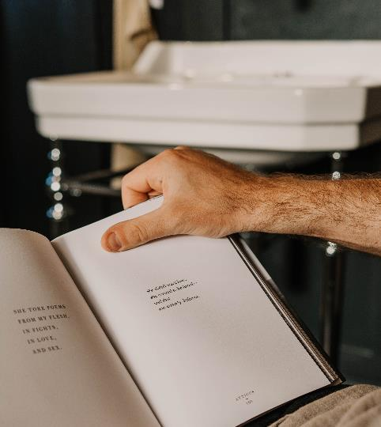
FUENTE
ELABORADO POR : slidesppt.net
IMAGES :
unsplash.com
pngwing.com
FONTS :
Abril Fatface
Arial Black
Montserrat
slidesppt.net
Notes:
slidesppt.net

Slide 30
RESOURCES

Slide 31
Fully Editable Icon Sets: A
Notes:
slidesppt.net

Slide 32
Fully Editable Icon Sets: B
Notes:
slidesppt.net

Slide 33
Fully Editable Icon Sets: C
Notes:
slidesppt.net

Slide 34
Presentation template by
Slidesppt.net
You are free to use this presentation for educational, personal and work purposes under Creative Commons Attribution License. But, keep the credits slide or mention Slidesppt in your presentation. Visit slidesppt.net

