Slide 1
slidesppt.net
Free Template
PENGUINS
Notes:
slidesppt.net

Slide 2
"The telephone has changed the way we communicate, but it cannot replace the warmth of a face-to-face conversation."

Slide 3
c
Table Of Contents
1. About Of The Day
2. History
3. Future Of Telephone
4. Celebration
5. Conclusion
Notes:
slidesppt.net

Slide 4
c
About The day
National Telephone Day is celebrated on April 25th to commemorate the invention of the telephone in 1876 by Alexander Graham Bell. This day is a great opportunity to recognize the importance of the telephone and its impact on communication.

Slide 5
c
History
The exact origin of National Telephone Day is unclear, but it is believed to have been first celebrated in the late 20th century, possibly around the time of the centennial anniversary of Alexander Graham Bell's invention of the telephone in 1876.
Notes:
slidesppt.net

Slide 6
The Evolution Of Communication Technology
Explore how the telephone paved the way for other forms of communication technology such as the radio, television, and internet.

Slide 7
c
The Art Of Conversation
Discuss the importance of good communication skills and how they can be developed through face-to-face and telephone conversations.
Notes:
slidesppt.net

Slide 8
c
Explore the ethical issues surrounding telephone use such as privacy, telemarketing, and phone scams.
The Ethics Of Telephone Use

Slide 9
c
The Role Of The Telephone In Business And Marketing
Discuss how businesses and marketers use the telephone to connect with customers and promote their products or services.
Notes:
slidesppt.net

Slide 10
c
The Future Of The Telephone
As technology advances, the telephone will become more advanced and more efficient. We can expect to see new features and capabilities that will make communication easier and more efficient. The telephone will continue to be an important part of our lives, and National Telephone Day is the perfect opportunity to celebrate its importance.

Slide 11
c
Celebrating Of The Day
National Telephone Day is a great opportunity to celebrate the invention of the telephone and its impact on our lives. There are many ways to celebrate this day, such as hosting a teleconference, having a phone conversation with a loved one, or simply taking some time to appreciate the telephone and its role in our lives.
Notes:
slidesppt.net

Slide 12
Timeline
1876
1876
1963
2017
Alexander Graham Bell makes the first successful telephone call in Boston, Massachusetts, to his assistant Thomas A. Watson.
The first rotary dial telephones are introduced, replacing the earlier crank-operated phones.
Touch-tone telephones are introduced, allowing users to dial numbers by pressing buttons rather than rotating a dial.
The number of smartphone users worldwide surpasses 2 billion.

Slide 13
Why We Love National Telephone Day
Convenience
The telephone has made communication more convenient and accessible than ever before, allowing people to connect with each other from anywhere in the world at any time.
Innovation
The invention of the telephone was a major technological innovation that paved the way for many other advancements in communication technology, such as the internet and social media.
Emotional Connection
Many people feel that the telephone allows for a deeper emotional connection than other forms of communication, allowing them to hear the tone, inflection, and emotion in a person's voice.
Notes:
slidesppt.net

Slide 14
Conclusion
National Telephone Day is a great opportunity to recognize the importance of the telephone and its impact on our lives. It is a day to celebrate the invention of the telephone and its role in our lives. It is also a day to appreciate the power of communication and the role that the telephone plays in our lives.

Slide 15
Portfolio Presentation Designed
Option Type
Content Here
I hope and I believe that this Template will your Time, Money and Reputation. You can simply impress your audience and add a unique zing and appeal to your Presentations.
Option Type
Content Here
I hope and I believe that this Template will your Time, Money and Reputation. You can simply impress your audience and add a unique zing and appeal to your Presentations.
Notes:
slidesppt.net

Slide 16
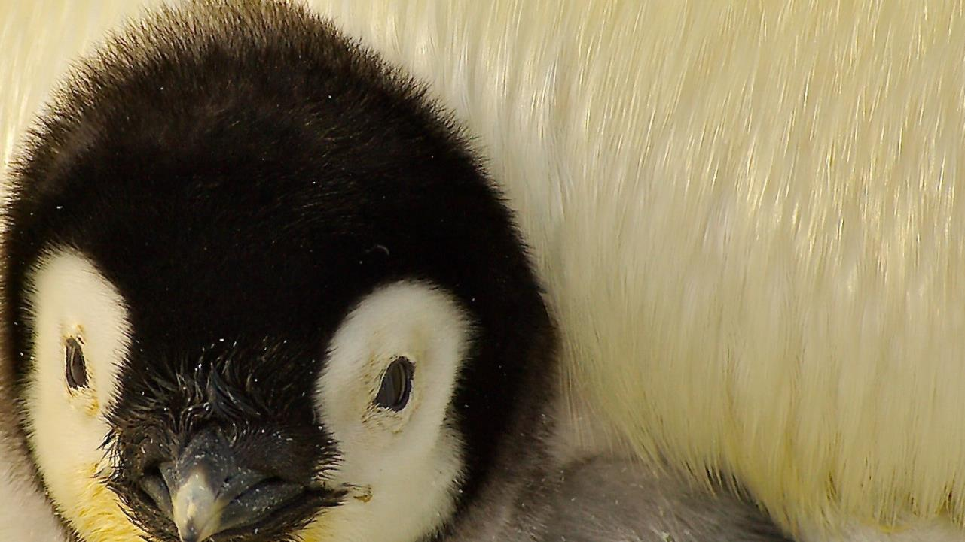
"The telephone is a virtual object. It exists only in the imagination of the speaker and listener."

Slide 17
THANKS!
slidesppt.net
Notes:
slidesppt.net

Slide 18
Instructions for use
In order to use this template, you must credit Slidesppt by keeping the thank you slide.
What you are allowed to do :
Use our templates for personal or educational presentations or printouts.
Edit and customize our templates for your own needs.
Link a page to a presentation template on your website or blog.
What you are not allowed to do :
Republish or redistribute our presentation templates, offline or online and even for free.
Offer Slidesppt templates (or a modified version of this Slidesppt Template) or include it in a database or any other product or service that offers downloadable images, icons or templates that may be subject to distribution or resale.
Useful links :
What you are allowed and not allowed to do: https://www.slidesppt.net/what-you-can-and-cannot-do-with-our-templates/
Frequently Asked Questions: https://www.slidesppt.net/frequently-asked-questions/
Tutorials and Tips: https://www.slidesppt.net/tutorials-and-tips/

Slide 19
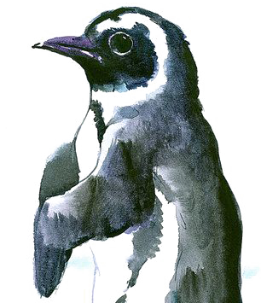
FUENTE
ELABORADO POR : slidesppt.net
IMAGES :
freepik.es
pngegg.com
pixabay.com
FONTS :
Roboto Bold
Segoe UI
slidesppt.net
Notes:
slidesppt.net

Slide 20
RESOURCES
Notes:
slidesppt.net

Slide 21
Fully Editable Icon Sets: A
Notes:
slidesppt.net

Slide 22
Fully Editable Icon Sets: B
Notes:
slidesppt.net

Slide 23
Fully Editable Icon Sets: C
Notes:
slidesppt.net

Slide 24
Presentation template by
Slidesppt.net
You are free to use this presentation for educational, personal and work purposes under Creative Commons Attribution License. But, keep the credits slide or mention Slidesppt in your presentation. Visit slidesppt.net

