Slide 1
slidesppt.net
TOURISM IN THE UNITED STATES
Free Templates
Insert the Subtitle of Your Presentation
Notes:
slidesppt.net

Slide 2
TOURISM
UNITED STATES
TOURISM IN THE UNITED STATES
PPT
PRESENTATION
Please place your content here, or by copying your text, select Paste in this box and choose to keep only the text. Please plac

Slide 3
TOURISM
UNITED STATES
PPT
Contents
01.Enter title
Everyone has their own dreams。
02.Enter title
Everyone has their own dreams。
03.Enter title
Everyone has their own dreams。
04.Enter title
Everyone has their own dreams。
Notes:
slidesppt.net

Slide 4
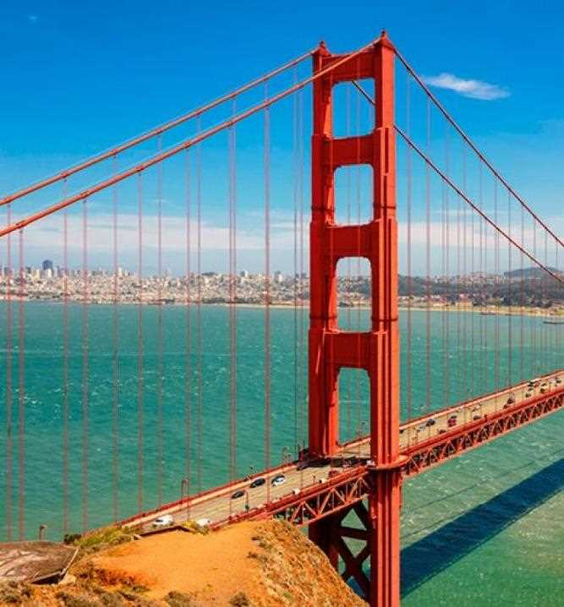
PART one
TOURISM
UNITED STATES
PPT
Please place your content here, or by copying your text, select Paste in this box and choose to keep only the text..
Please place your content here, or by copying your text, select Paste in this box and choose to keep only the text..

Slide 5
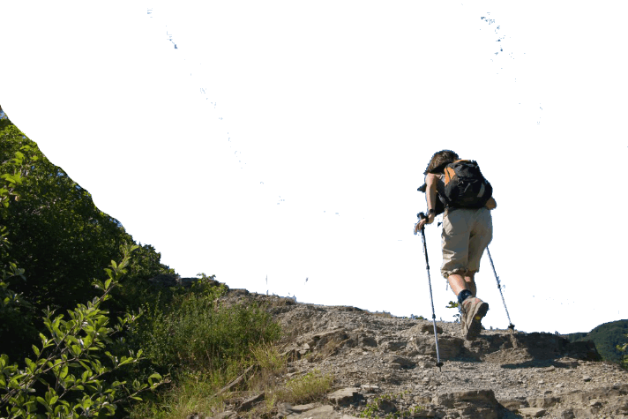
TOURISM
UNITED STATES
PPT
Everyone has their own dreams, I am the same. But my dream is not a lawyer, not a doctor, not actors, not even an industry.
Everyone has their own dreams, I am the same. But my dream is not a lawyer, not a doctor, not actors, not even an industry.
Everyone has their own dreams, I am the same. But my dream is not a lawyer, not a doctor, not actors, not even an industry.
Everyone has their own dreams, I am the same. But my dream is not a lawyer, not a doctor, not actors, not even an industry.
Everyone has their own dreams, I am the same. But my dream is not a lawyer, not a doctor, not actors, not even an industry.
Notes:
slidesppt.net

Slide 6
TOURISM
UNITED STATES
PPT
BIAOTI
BIAOTI
Everyone has their own dreams, I am the same.
Everyone has their own dreams, I am the same.
BIAOTI
BIAOTI
Everyone has their own dreams, I am the same.
Everyone has their own dreams, I am the same.
Notes:
slidesppt.net

Slide 7
TOURISM
UNITED STATES
PPT
BIANJIBIAOTI
Everyone has their own dreams, I am the same. But my dream is not a lawyer, not a doctor, not actors, not even an industry.
Everyone has their own dreams, I am the same. But my dream is not a lawyer, not a doctor, not actors, not even an industry.
Everyone has their own dreams, I am the same. But my dream is not a lawyer, not a doctor, not actors, not even an industry.
Simple Atmosphere Universal Template
Notes:
slidesppt.net

Slide 8
2
PART one
TOURISM
UNITED STATES
PPT
Please place your content here, or by copying your text, select Paste in this box and choose to keep only the text..
Please place your content here, or by copying your text, select Paste in this box and choose to keep only the text..
Notes:
slidesppt.net

Slide 9
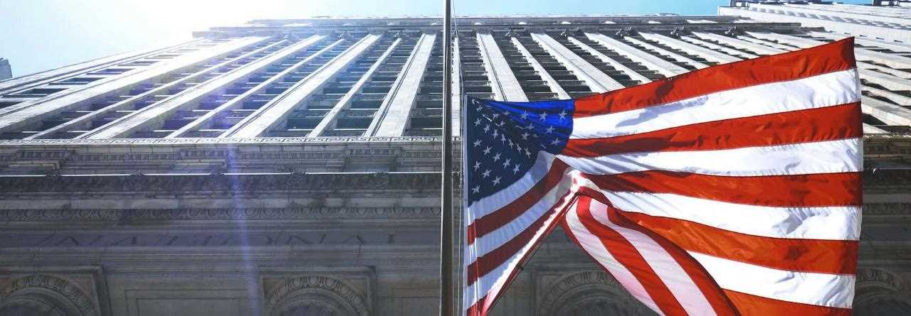
TOURISM
UNITED STATES
PPT
BIANJIBIAOTI
BIANJIBIAOTI
Everyone has their own dreams, I am the same. But my dream is not a lawyer, not a doctor, not actors, not even an industry.
Everyone has their own dreams, I am the same. But my dream is not a lawyer, not a doctor, not actors, not even an industry.
Everyone has their own dreams, I am the same. But my dream is not a lawyer, not a doctor, not actors, not even an industry.
Everyone has their own dreams, I am the same. But my dream is not a lawyer, not a doctor, not actors, not even an industry.
Everyone has their own dreams, I am the same. But my dream is not a lawyer, not a doctor, not actors, not even an industry.
Everyone has their own dreams, I am the same. But my dream is not a lawyer, not a doctor, not actors, not even an industry.
Notes:
slidesppt.net

Slide 10
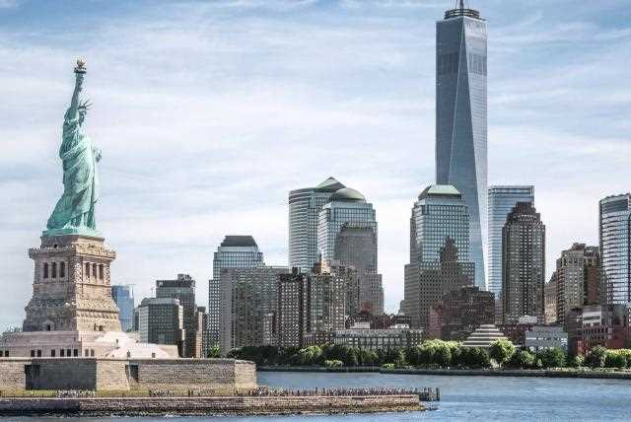
TOURISM
UNITED STATES
PPT
DANJICICHUSHURUBIAOTI
DANJICICHUSHURUBIAOTI
Simple Atmosphere Universal Template
Simple Atmosphere Universal Template
Everyone has their own dreams, I am the same. But my dream is not a lawyer, not a doctor, not actors, not even an industry. Everyone has their own dreams, I am the same. But my dream is not a lawyer, not a doctor, not actors, not even an industry.
Everyone has their own dreams, I am the same. But my dream is not a lawyer, not a doctor, not actors, not even an industry.
Everyone has their own dreams, I am the same. But my dream is not a lawyer.

Slide 11
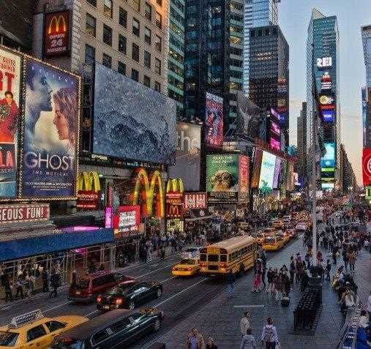
3
PART one
TOURISM
UNITED STATES
PPT
Please place your content here, or by copying your text, select Paste in this box and choose to keep only the text..
Please place your content here, or by copying your text, select Paste in this box and choose to keep only the text..
Notes:
slidesppt.net

Slide 12
TOURISM
UNITED STATES
PPT
BIANJIBIAOTI
Simple Atmosphere Universal Template
Everyone has their own dreams, I am the same. But my dream is not a lawyer, not a doctor, not actors, not even an industry. Everyone has their own dreams, I am the same. But my dream is not a lawyer, not a doctor, not actors, not even an industry.
Everyone has their own dreams, I am the same. But my dream is not a lawyer, not a doctor, not actors, not even an industry.
Simple Atmosphere Universal Template

Slide 13
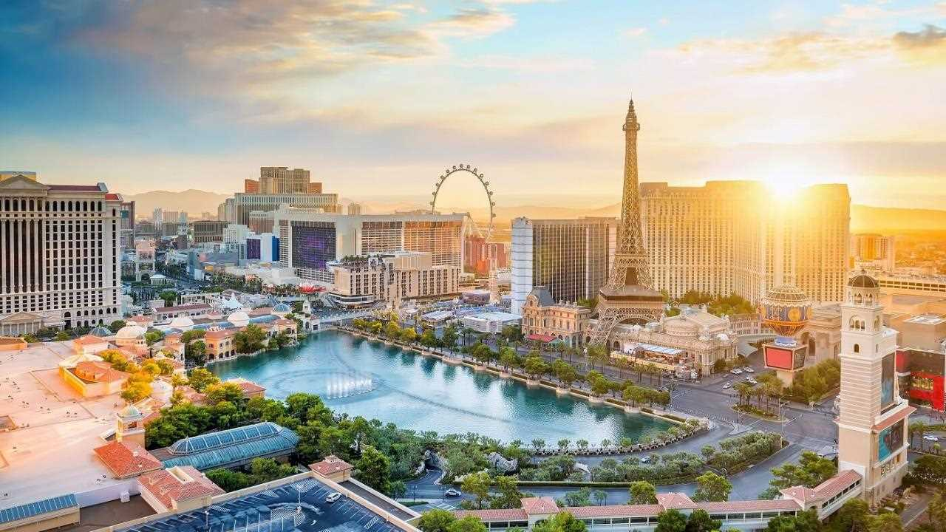
DANJICICHUSHURUBIAOTI
Simple Atmosphere Universal Template
+Everyone has their own dreams, I am the same. But my dream is not a lawyer.
+Everyone has their own dreams, I am the same. But my dream is not a lawyer.
+Everyone has their own dreams, I am the same. But my dream is not a lawyer.+Everyone has their own dreams, I am the same. But my dream is not a lawyer.
+Everyone has their own dreams, I am the same. But my dream is not a lawyer.
Notes:
slidesppt.net

Slide 14
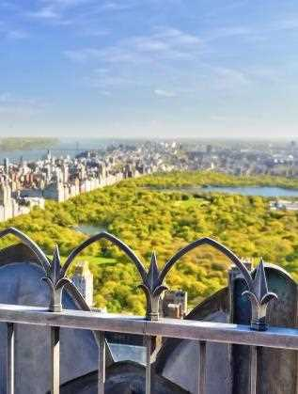
TOURISM
UNITED STATES
PRESENTATION
PPT
01.
Please place your content here, or by copying your text, select Paste in this box and choose to keep only the text..
Please place your content here, or by copying your text, select Paste in this box and choose to keep only the text..
Please place your content here, or by copying your text, select Paste in this box and choose to keep only the text..
02.
Please place your content here, or by copying your text, select Paste in this box and choose to keep only the text..
01
SLIDE AND TECHNOLOGY
03.
02
SLIDE AND TECHNOLOGY
Please place your content here, or by copying your text, select Paste in this box and choose to keep only the text..
03
SLIDE AND TECHNOLOGY
04.
Please place your content here, or by copying your text, select Paste in this box and choose to keep only the text..

Slide 15
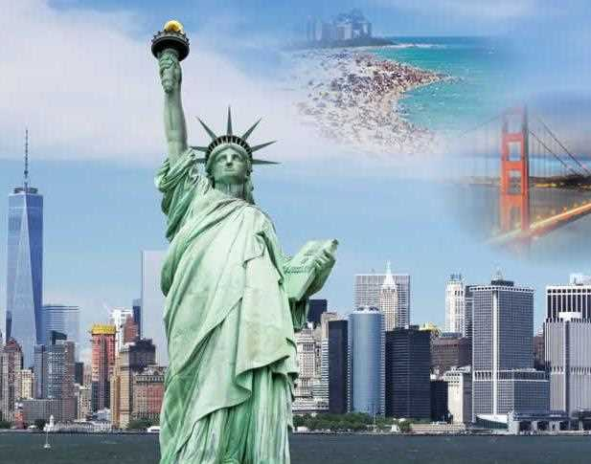
4
PART one
TOURISM
UNITED STATES
PPT
Please place your content here, or by copying your text, select Paste in this box and choose to keep only the text..
Please place your content here, or by copying your text, select Paste in this box and choose to keep only the text..
Notes:
slidesppt.net

Slide 16
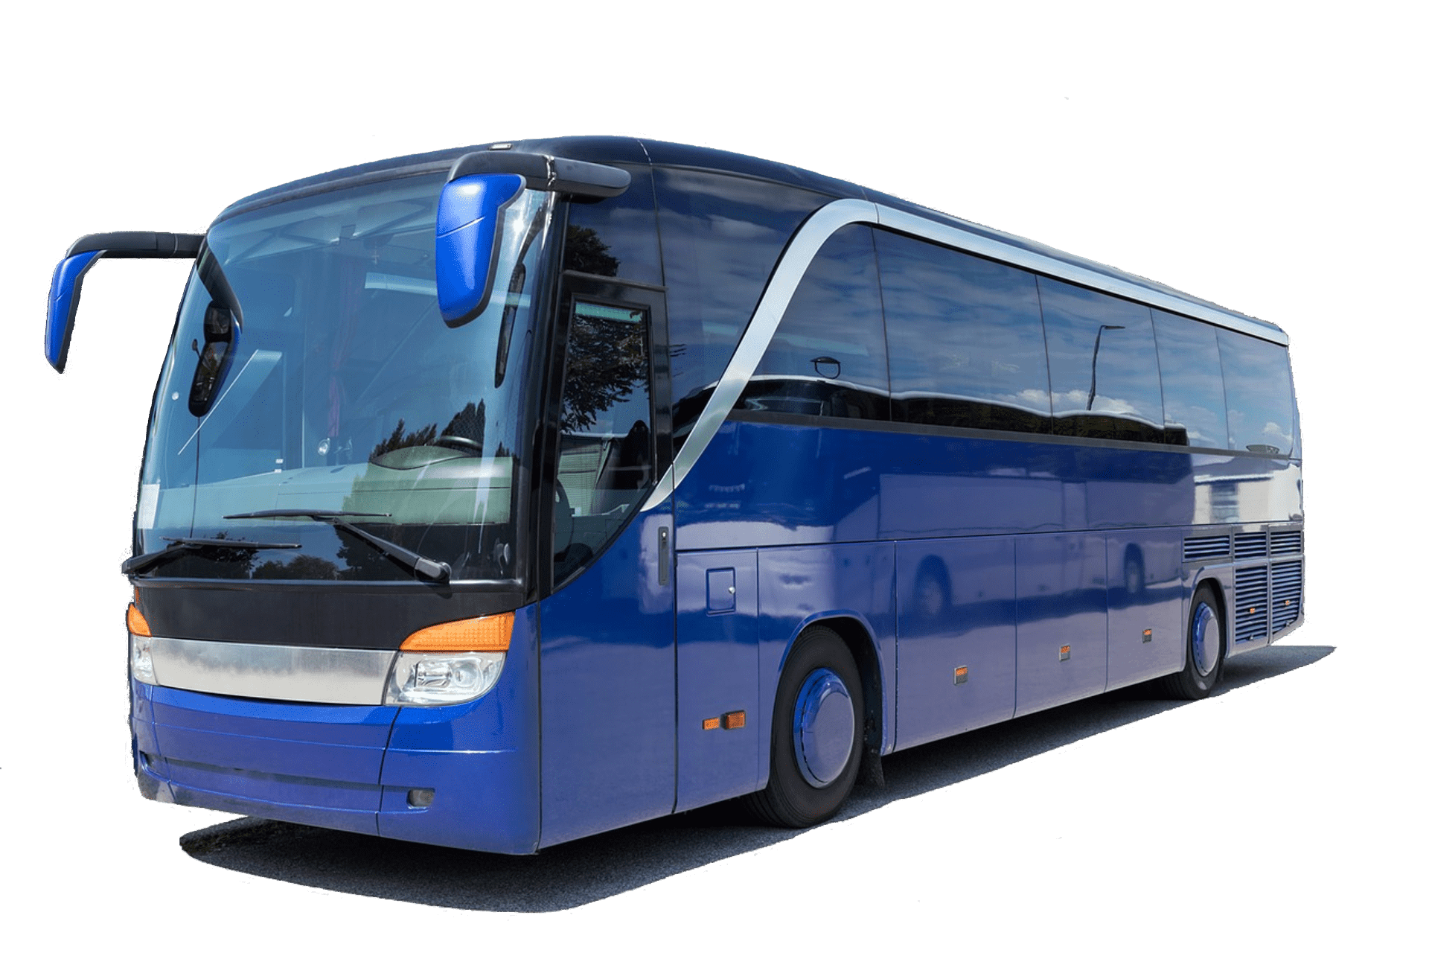
TOURISM
UNITED STATES
Everyone has their own dreams, I am the same. But my dream is not a lawyer, not a doctor, not actors, not even an industry.
PPT
BIANJIBIAOTI
Everyone has their own dreams, I am the same. But my dream is not a lawyer, not a doctor, not actors, not even an industry.
Everyone has their own dreams, I am the same. But my dream is not a lawyer, not a doctor, not actors, not even an industry.
Notes:
slidesppt.net

Slide 17
TOURISM
UNITED STATES
PPT
BIAOTI
BIAOTI
BIAOTI
Everyone has their own dreams, I am the same. But my dream is not a lawyer
Everyone has their own dreams, I am the same. But my dream is not a lawyer
Everyone has their own dreams, I am the same. But my dream is not a lawyer
Notes:
slidesppt.net

Slide 18
Thanks!
Please keep this slide for attribution
slidesppt.net

Slide 19
Instructions for use
In order to use this template, you must credit Slidesppt by keeping the thank you slide.
What you are allowed to do :
Use our templates for personal or educational presentations or printouts.
Edit and customize our templates for your own needs.
Link a page to a presentation template on your website or blog.
What you are not allowed to do :
Republish or redistribute our presentation templates, offline or online and even for free.
Offer Slidesppt templates (or a modified version of this Slidesppt Template) or include it in a database or any other product or service that offers downloadable images, icons or templates that may be subject to distribution or resale.
Useful links :
What you are allowed and not allowed to do: https://www.slidesppt.net/what-you-can-and-cannot-do-with-our-templates/
Frequently Asked Questions: https://www.slidesppt.net/frequently-asked-questions/
Tutorials and Tips: https://www.slidesppt.net/tutorials-and-tips/
Notes:
slidesppt.net

Slide 20
FUENTE
ELABORADO POR : slidesppt.net
IMAGES :
freepik.es
pixabay.com
pngegg.com
FONTS :
Montserrat
Montserrat Light
Century Gothic
slidesppt.net
Notes:
slidesppt.net

Slide 21
Fully Editable Icon Sets: A
Notes:
slidesppt.net

Slide 22
Fully Editable Icon Sets: B
Notes:
slidesppt.net

Slide 23
Fully Editable Icon Sets: C
Notes:
slidesppt.net

Slide 24
Presentation template by
Slidesppt.net
You are free to use this presentation for educational, personal and work purposes under Creative Commons Attribution License. But, keep the credits slide or mention Slidesppt in your presentation. Visit slidesppt.net

