Slide 1
Customs
TRINIDAD AND TOBAGO
Here is where your presentation begins
FREE TEMPLATES
slidesppt.net
Notes:
slidesppt.net

Slide 2
INTRODUCTION
You can give here a brief description of the topic you want to talk about. For example, if you want to talk about Mercury, you can say that it’s the smallest planet in the entire Solar System
Notes:
slidesppt.net

Slide 3
Objectives
Carnival in
TRINIDAD AND TOBAGO
You can enter a subtitle here if you need it
Notes:
slidesppt.net

Slide 4
01
02
Table of contents
03
04
Objectives
Methodology
Here you can describe the topic of the section
Here you can describe the topic of the section
Results Analysis
Conclusions
Here you can describe the topic of the section
Here you can describe the topic of the section
Notes:
slidesppt.net

Slide 5
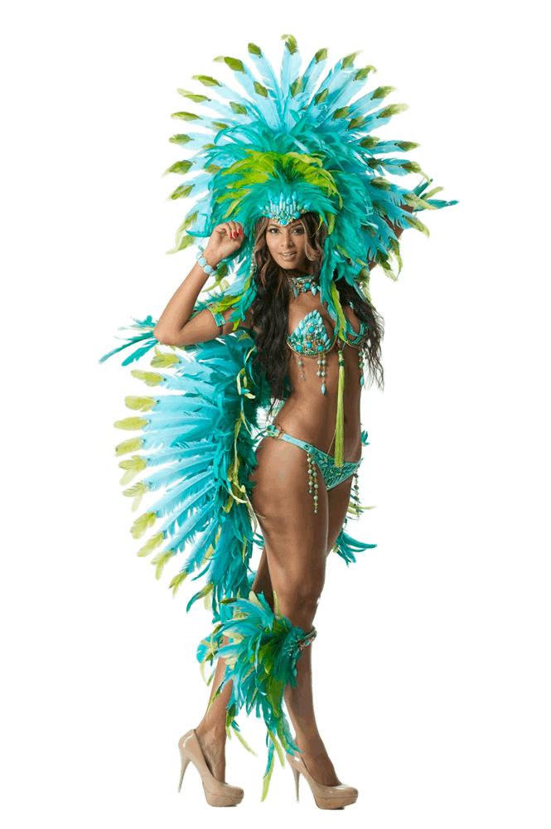
The better carnival
Mercury is the closest planet to the Sun and the smallest one in the Solar System—it’s only a bit larger than the Moon. The planet’s name has nothing to do with the liquid metal
Mercury is the closest planet to the Sun and the smallest one in the Solar System—it’s only a bit larger than the Moon. The planet’s name has nothing to do with the liquid metal
Notes:
slidesppt.net

Slide 6
Carnival in
TRINIDAD AND TOBAGO
35%
Ginger
Mercury is quite a small planet
25%
Garlic
Mars is actually a very cold place
Notes:
slidesppt.net

Slide 7
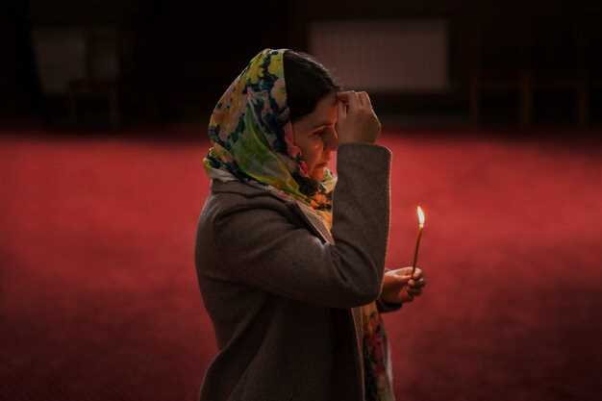
—Someone Famous
Conclusions
Oration Musselman in
TRINIDAD AND TOBAGO
“This is a quote, words full of wisdom that someone important said and can make the reader get inspired”
Notes:
slidesppt.net

Slide 8
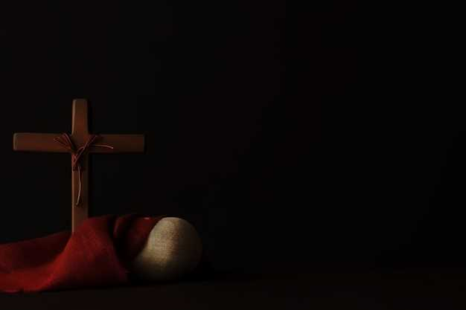
WHOA!
Pascua Cristiana in
TRINIDAD AND TOBAGO
This can be the part of the presentation where you introduce yourself, write your email…
Notes:
slidesppt.net

Slide 9
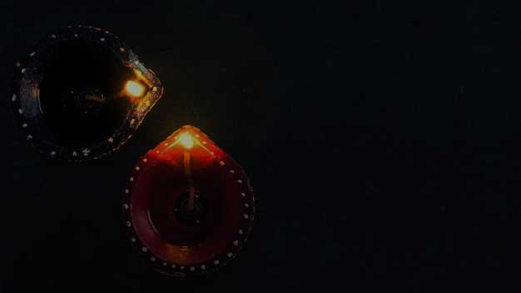
Divali Hindu in
TRINIDAD AND TOBAGO
Jupiter
Jupiter is a gas giant and the biggest
Mars
Saturn
Despite being red, Mars is a cold place
Yes, Saturn is the ringed one
Notes:
slidesppt.net

Slide 10
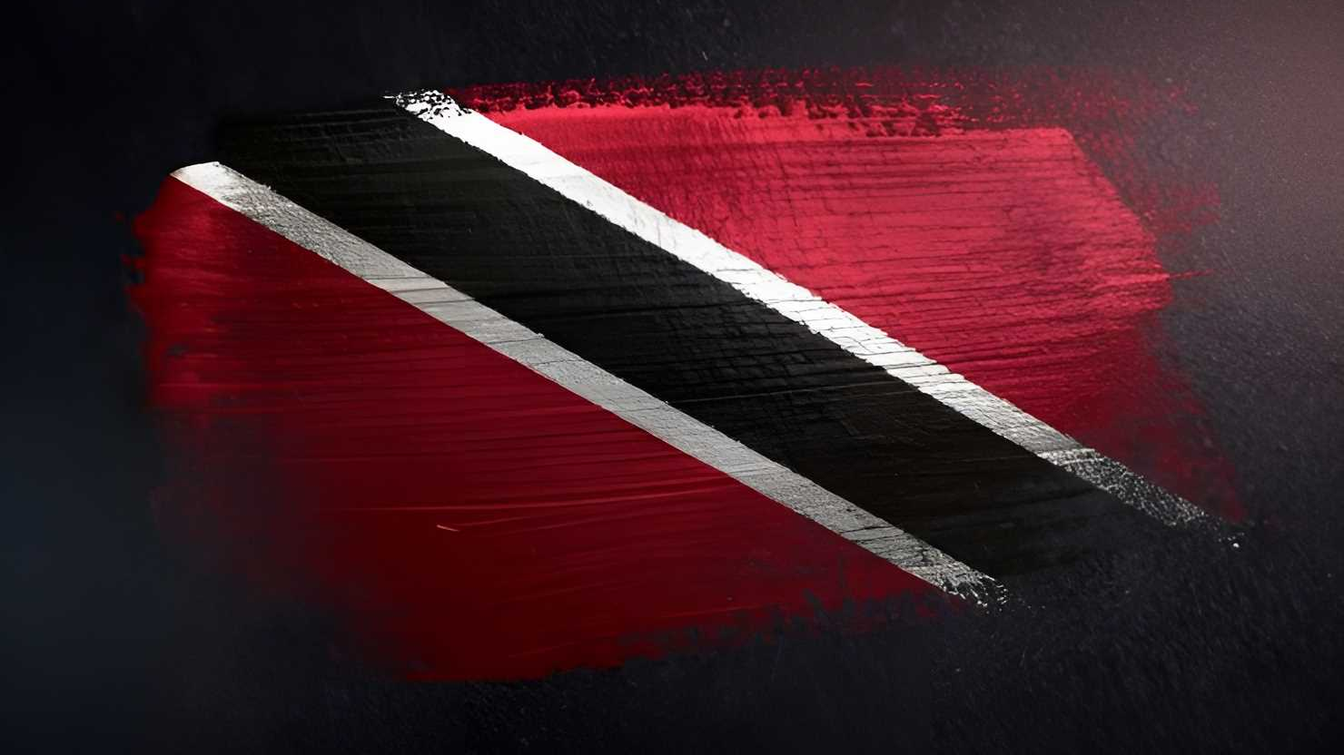
4,498,300,000
People
TRINIDAD AND TOBAGO
Big numbers catch your audience’s attention

Slide 11
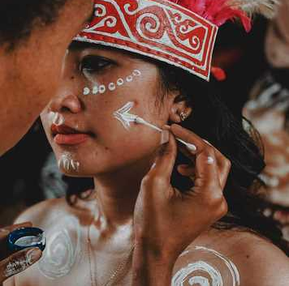
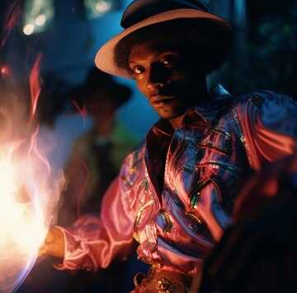
People in
TRINIDAD AND TOBAGO
Mercury
Mars
Mercury is the smallest planet
Despite being red, it’s cold
Notes:
slidesppt.net

Slide 12
01
02
03
04
About this
TRINIDAD AND TOBAGO
Mercury
Mars
Venus
Saturn
Mercury is the smallest planet
Despite being red, it’s cold
Venus has a beautiful name
It’s a gas giant and has rings

Slide 13
Get a modern PowerPoint Presentation that is beautifully designed.
Get a modern PowerPoint Presentation that is beautifully designed.
Get a modern PowerPoint Presentation that is beautifully designed.
Get a modern PowerPoint Presentation that is beautifully designed. Easy to change colors, photos and Text.
Get a modern PowerPoint Presentation that is beautifully designed. Easy to change colors, photos and Text.
Customs
TRINIDAD AND TOBAGO
Get a modern PowerPoint Presentation that is beautifully designed. Easy to change colors, photos and Text.
Get a modern PowerPoint Presentation that is beautifully designed. Easy to change colors, photos and Text.
Notes:
slidesppt.net

Slide 14
People in
TRINIDAD AND TOBAGO
Theory 1
Mercury is the closest planet to the Sun and the smallest one in the Solar System
Theory 2
Venus has a beautiful name and is the second planet from the Sun
You can simply impress your audience and add a unique zing and appeal to your Presentations.

Slide 15
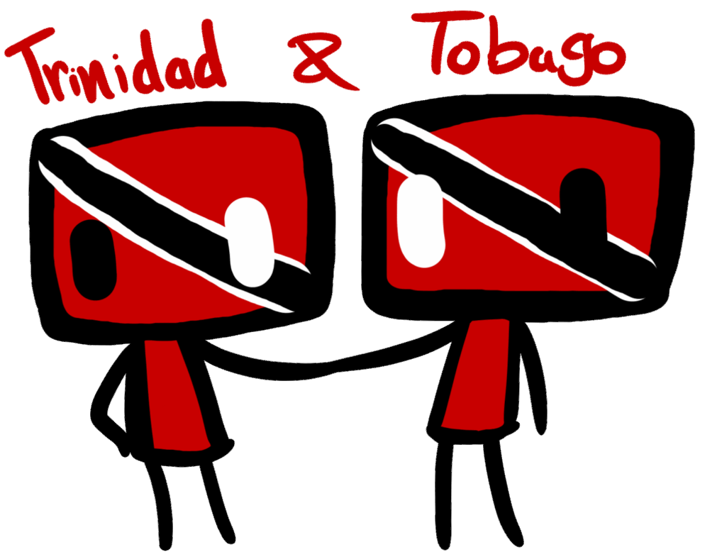
Customs of
Theory 1
Theory 2
Mercury is the closest planet to the Sun and the smallest one in the Solar System—it’s only a bit larger than the Moon. The planet’s name has nothing to do with the liquid metal
Mercury is the closest planet to the Sun and the smallest one in the Solar System—it’s only a bit larger than the Moon. The planet’s name has nothing to do with the liquid metal
Venus has a beautiful name and is the second planet from the Sun
Content Here
Notes:
slidesppt.net

Slide 16
You are Trinidad and tobago
Mercury
Venus
Mercury is the smallest planet
Venus has a beautiful name
Saturn
Jupiter
Yes, this is the ringed one
It’s the biggest planet of them all

Slide 17
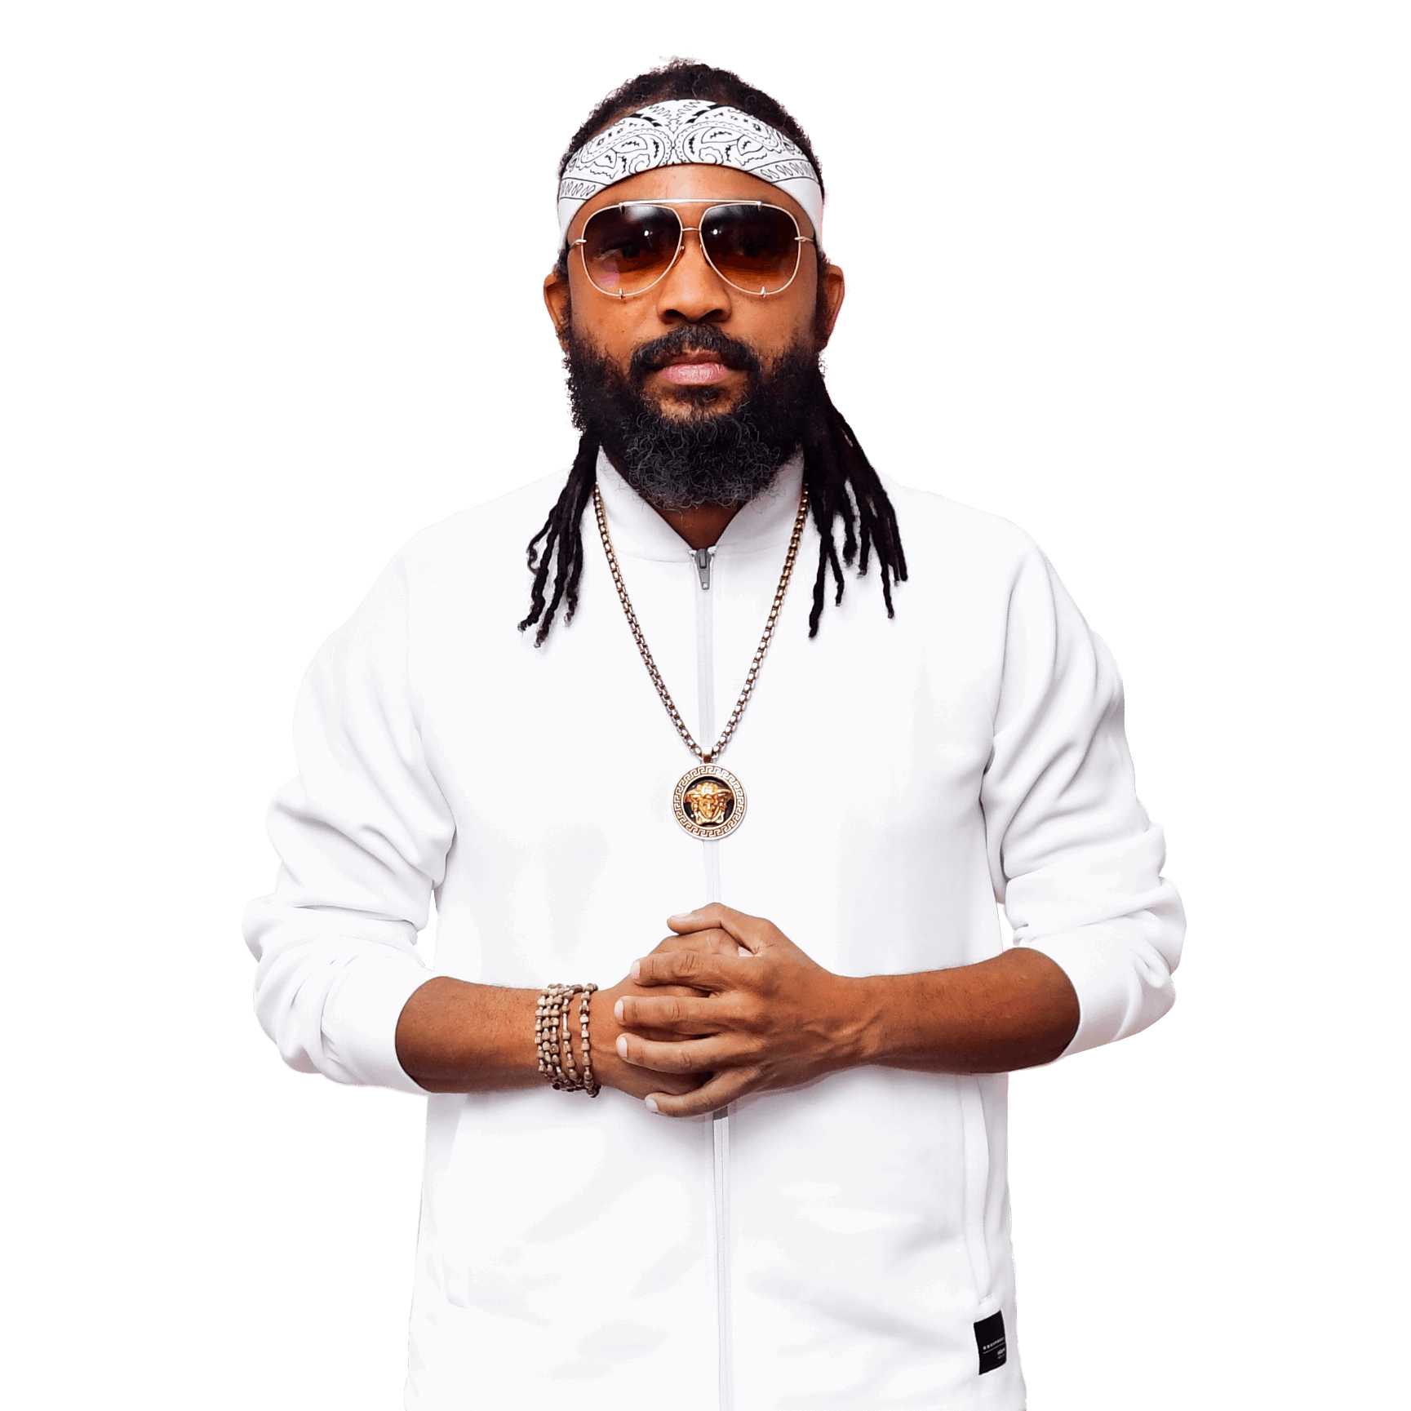
People in
TRINIDAD AND TOBAGO
Mercury is the closest planet to the Sun and the smallest one in the Solar System—it’s only a bit larger than the Moon. The planet’s name has nothing to do with the liquid metal
Mercury is the closest planet to the Sun and the smallest one in the Solar System—it’s only a bit larger than the Moon. The planet’s name has nothing to do with the liquid metal
Notes:
slidesppt.net

Slide 18
Thanks
FREE TEMPLATES
We are
slidesppt.net

Slide 19
Instructions for use
In order to use this template, you must credit Slidesppt by keeping the thank you slide.
What you are allowed to do :
Use our templates for personal or educational presentations or printouts.
Edit and customize our templates for your own needs.
Link a page to a presentation template on your website or blog.
What you are not allowed to do :
Republish or redistribute our presentation templates, offline or online and even for free.
Offer Slidesppt templates (or a modified version of this Slidesppt Template) or include it in a database or any other product or service that offers downloadable images, icons or templates that may be subject to distribution or resale.
Useful links :
What you are allowed and not allowed to do: https://www.slidesppt.net/what-you-can-and-cannot-do-with-our-templates/
Frequently Asked Questions: https://www.slidesppt.net/frequently-asked-questions/
Tutorials and Tips: https://www.slidesppt.net/tutorials-and-tips/
Notes:
slidesppt.net

Slide 20
FUENTE
ELABORADO POR : slidesppt.net
IMAGES :
freepik.es
pngegg.com
peakpx.com
FONTS :
Lora
Josefin Slab Medium
Arial (Títulos)
slidesppt.net
Notes:
slidesppt.net

Slide 21
Fully Editable Icon Sets: A
Notes:
slidesppt.net

Slide 22
Fully Editable Icon Sets: B
Notes:
slidesppt.net

Slide 23
Fully Editable Icon Sets: C
Notes:
slidesppt.net

Slide 24
Presentation template by
Slidesppt.net
You are free to use this presentation for educational, personal and work purposes under Creative Commons Attribution License. But, keep the credits slide or mention Slidesppt in your presentation. Visit slidesppt.net
Notes:
slidesppt.net

