Slide 1
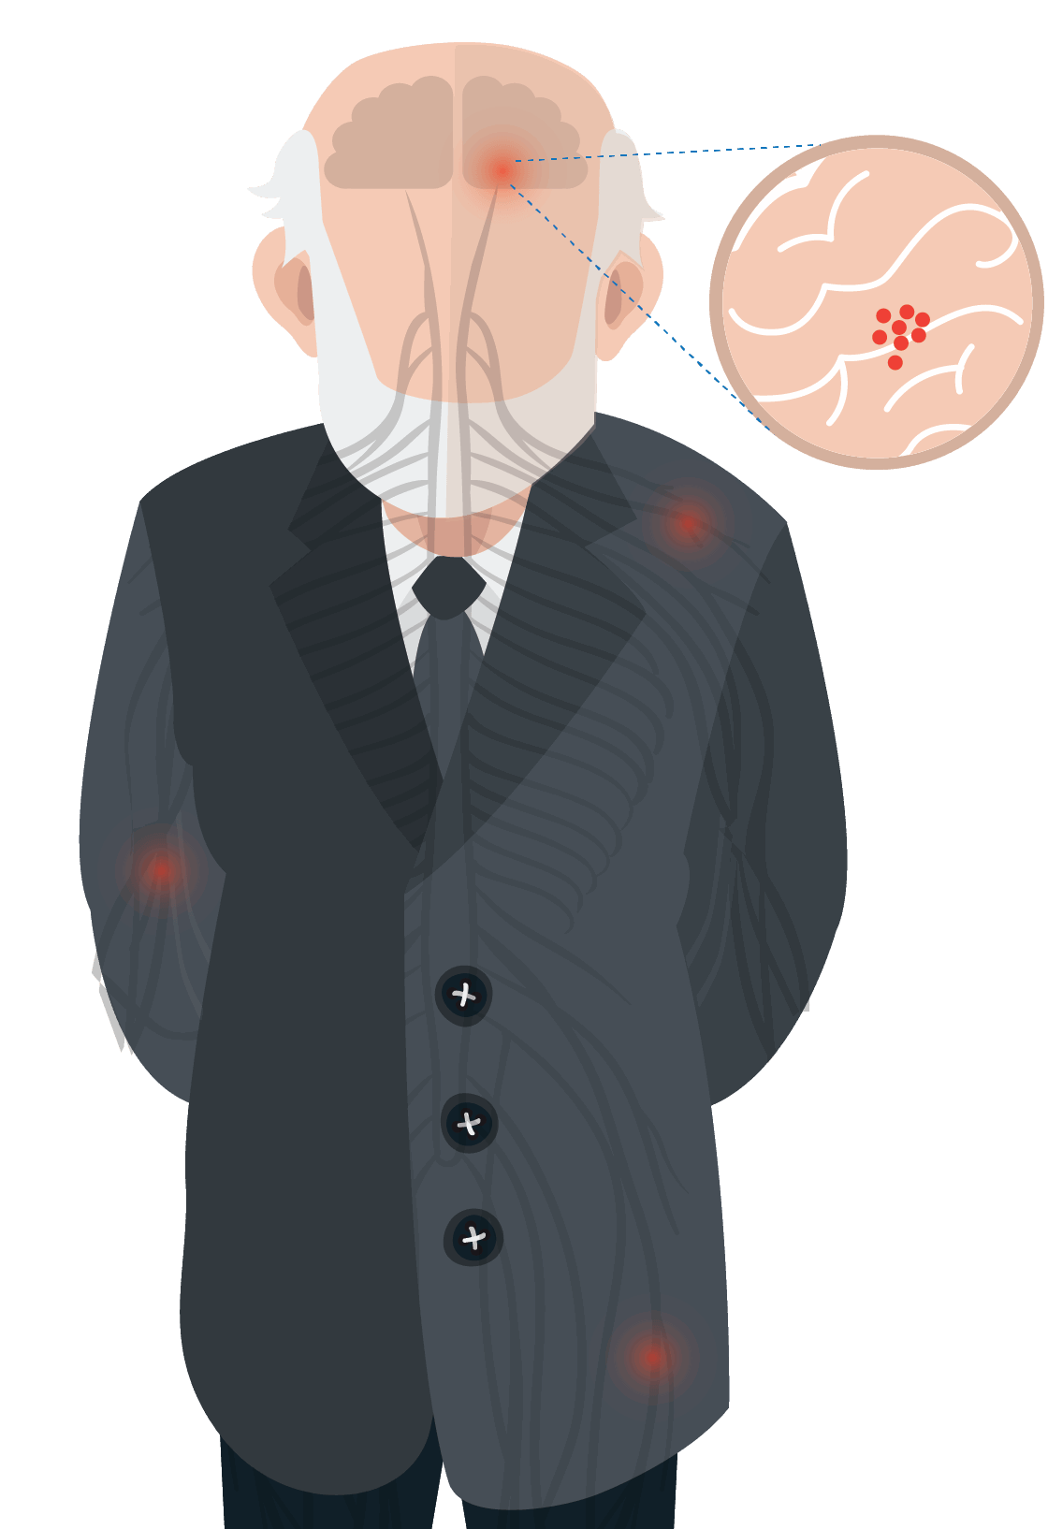
Free Template
WORLD PARKINSON'S DAY
Insert the Sub Title of Your Presentation
slidesppt.net
Notes:
slidesppt.net

Slide 2
1
History
Table Of Content
2
Facts
3
Astronomy Day typically includes a wide range of activities and events that promote astronomy and space exploration. Some of the common activities and events that are organized on Astronomy Day are:
Dates

Slide 3
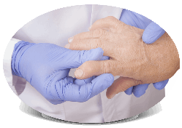
Introduction
Astronomy Day is a day dedicated to the appreciation of astronomy and its related sciences. It is celebrated annually and is often marked with public events such as star parties, lectures, and telescope viewing sessions. The day is intended to raise awareness about astronomy and its importance in our lives. It is also a great way to introduce people to the wonders of the night sky and the science behind it.
Notes:
slidesppt.net

Slide 4
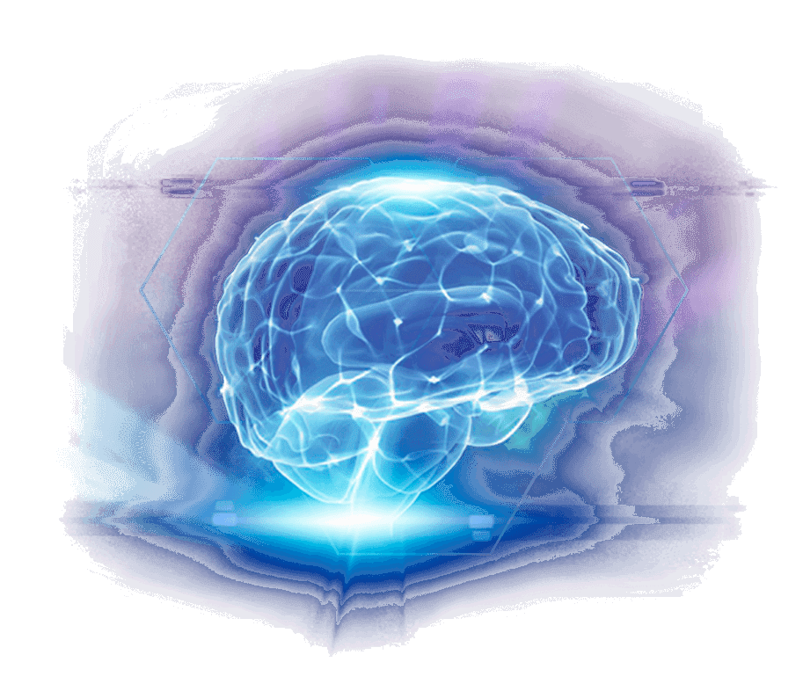
History
Astronomy Day typically includes a wide range of activities and events that promote astronomy and space exploration. Some of the common activities and events that are organized on Astronomy Day are:

Slide 5
Astronomy Day is an annual event celebrated around the world to promote and celebrate astronomy and space exploration. The event is usually held on a Saturday in either late April or early May, and is organized by astronomy clubs, planetariums, museums, and other institutions that promote astronomy and space science. Astronomy Day typically includes a variety of activities and events, such as stargazing parties, lectures by professional astronomers, exhibits of space-related artifacts and images, planetarium shows, and hands-on workshops for children and adults.
WORLD PARKINSON'S DAY
Astronomy Day typically includes a wide range of activities and events that promote astronomy and space exploration. Some of the common activities and events that are organized on Astronomy Day are:
Notes:
slidesppt.net

Slide 6
WORLD PARKINSON'S DAY
Astronomy Day typically includes a wide range of activities and events that promote astronomy and space exploration. Some of the common activities and events that are organized on Astronomy Day are:
Stargazing Parties
Astronomy Day often includes stargazing parties where people gather to observe the night sky through telescopes, binoculars, or just with their naked eye.
Planetarium Shows
Many planetariums offer special shows and presentations on Astronomy Day, where visitors can learn about the latest discoveries in space
Exhibits and Displays
Museums, science centers, and other institutions often organize exhibits and displays related to astronomy and space science, showcasing artifacts

Slide 7
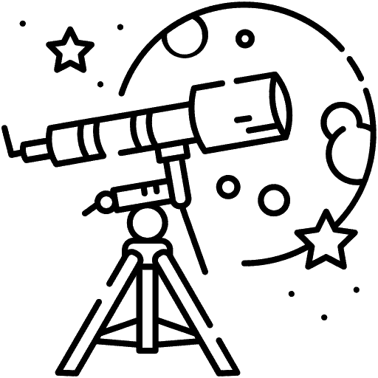
WORLD PARKINSON'S DAY
How To Celebrate
Attend an astronomy event
Look for local events hosted by astronomy clubs, planetariums, observatories, or science museums.
Visit a planetarium
Many planetariums offer special shows or activities for Astronomy Day. Planetarium shows are a great way to learn about the night sky
Go stargazing
Find a dark location away from city lights and observe the night sky. You can use a pair of binoculars or a telescope
Notes:
slidesppt.net

Slide 8
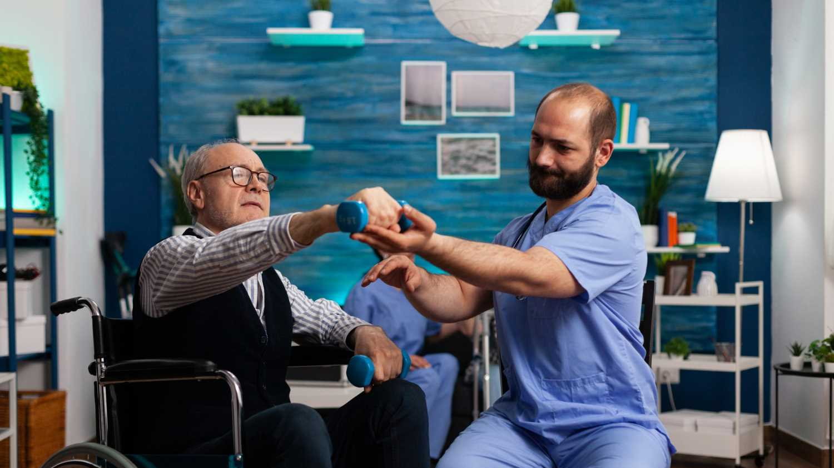
WORLD PARKINSON'S DAY
Why We Celebrate
Astronomy Day is an annual event celebrated in many countries around the world, usually on the Saturday closest to the first quarter moon of the spring or fall equinox. The purpose of Astronomy Day is to promote astronomy and to encourage people to learn more about the science of astronomy and the universe. Astronomy Day was first established in 1973 by Doug Berger, the president of the Astronomical Association of Northern California. Since then, it has become a popular event celebrated by astronomy enthusiasts, amateur astronomers, and professional astronomers alike.

Slide 9
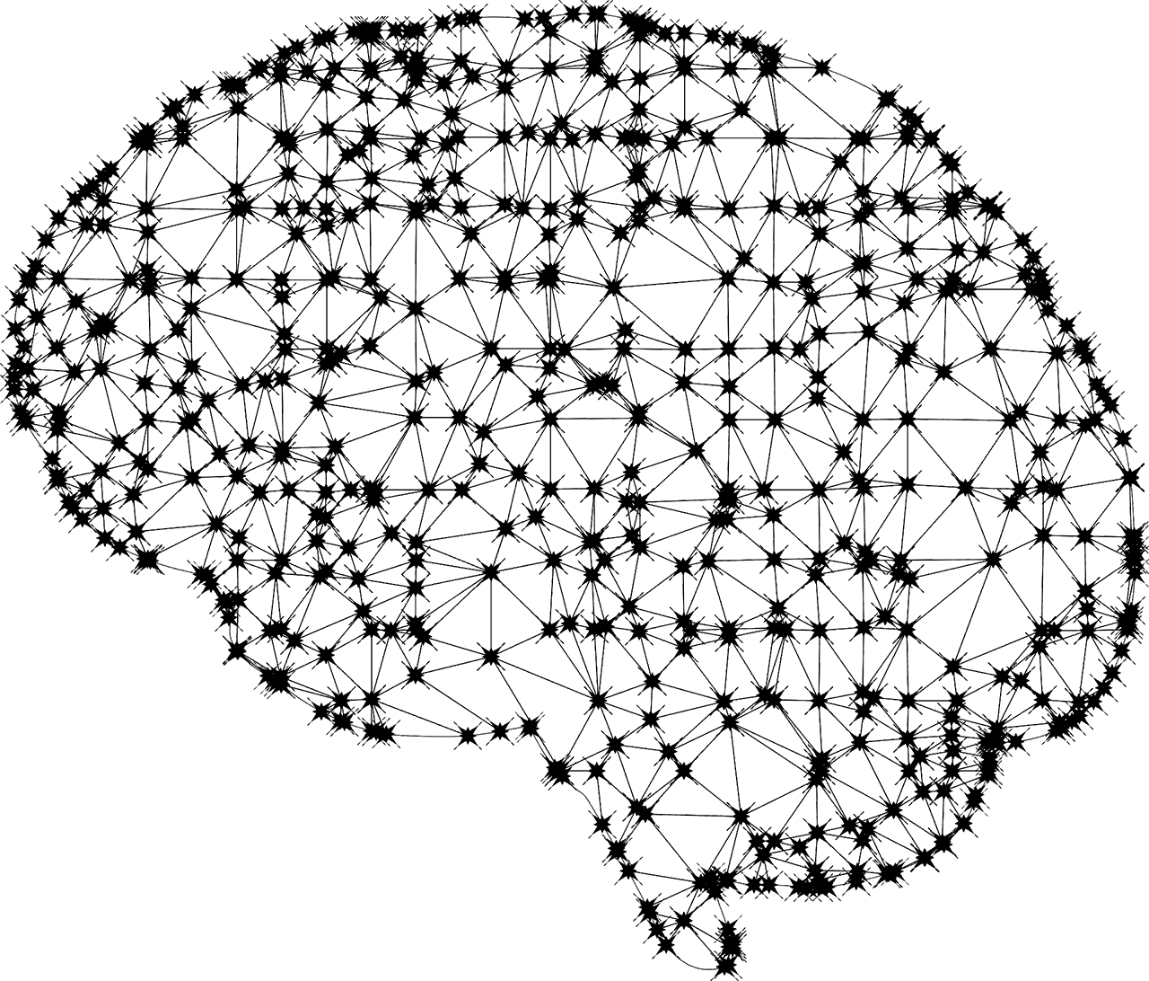
WORLD PARKINSON'S DAY
Favorite Place To Celebrate
Overall, the symbols of Astronomy Day are intended to inspire people to explore the universe, to learn more about the science of astronomy, and to appreciate the beauty and mystery of the cosmos.
A stylized representation of the sun, moon, or Earth, which are some of the most important objects in our solar system.
A graphic or logo that incorporates the words "Astronomy Day" or the date of the event.
Planets or moons, which are fascinating objects that can be seen with the naked eye or through a telescope.
Notes:
slidesppt.net

Slide 10
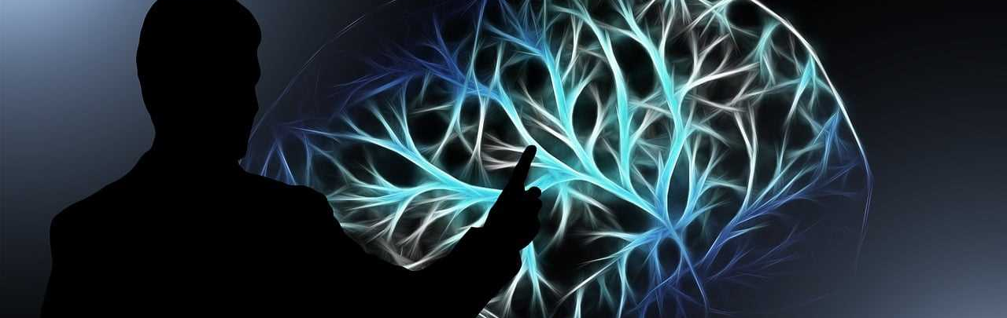
WORLD PARKINSON'S DAY
Check with your local planetarium, science museum, or observatory. These organizations often have connections with local astronomy clubs and can provide information on how to get involved.
Search online for astronomy clubs in your area. Websites like Meetup.com, Astronomy.com, and Sky & Telescope have directories of astronomy clubs and events.
Check with your local library or community center. They may have information about astronomy clubs or may even host their own stargazing events.
Notes:
slidesppt.net

Slide 11
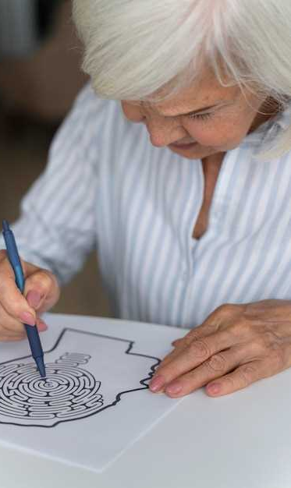
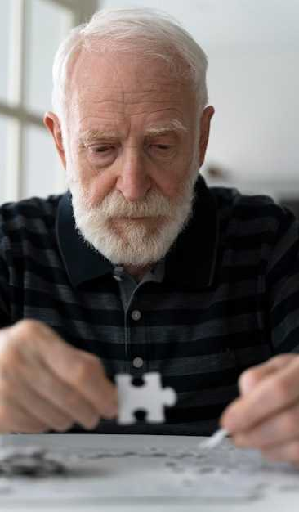
WORLD PARKINSON'S DAY
Attend an Astronomy Day event. Many astronomy clubs participate in Astronomy Day celebrations and offer information about their organization and upcoming events.
Ask friends or family members if they know of any local astronomy clubs. You may be surprised to find that someone you know is already a member of a local club.
Once you have identified a local astronomy club, you can attend a meeting or event to learn more about the club and its activities. Most clubs welcome new members and are eager to share their knowledge and passion for astronomy.
Notes:
slidesppt.net

Slide 12
WORLD PARKINSON'S DAY
It could be the part of the presentation where you can introduce yourself, write
your email…
Notes:
slidesppt.net

Slide 13
WORLD PARKINSON'S DAY
1
Astronomy Day is celebrated twice a year, once in the spring and once in the fall, on the Saturday closest to the first quarter moon.
2
Astronomy Day is celebrated twice a year, once in the spring and once in the fall, on the Saturday closest to the first quarter moon.
3
Astronomy Day is celebrated twice a year, once in the spring and once in the fall, on the Saturday closest to the first quarter moon.
People in the world
Notes:
slidesppt.net

Slide 14
WORLD PARKINSON'S DAY
1,000,000
A stylized representation of the sun, moon, or Earth, which are some of the most important objects in our solar system.
There are more stars in the universe than there are grains of stand on all of earth’s beaches!

Slide 15
WORLD PARKINSON'S DAY
1
Stellar Nebula
A star begins its life as a cloud of gas and dust called a stellar nebula. Gravity causes the nebula to collapse inward, and it becomes denser and hotter over time.
2
Protostar
As the gas and dust continue to collapse, the center of the nebula becomes a protostar, a hot and dense ball of gas that is not yet hot enough to sustain nuclear fusion.
3
Main Sequence
A When the temperature and pressure in the protostar reach a critical point, nuclear fusion begins, and the star enters the main sequence phase.
Notes:
slidesppt.net

Slide 16
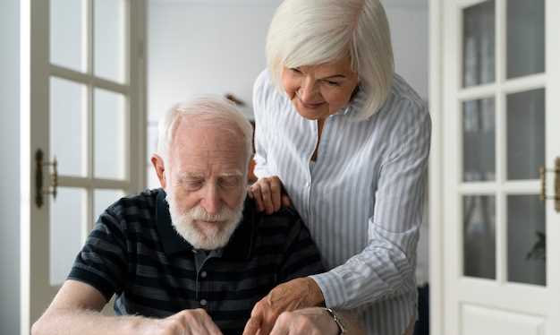
The Life Cycle Of Star
4
Red Giant
As a star runs out of hydrogen fuel in its core, it begins to expand and cool, becoming a red giant. In this phase, the star fuses heavier elements such as helium
5
Planetary Nebula
Eventually, the red giant sheds its outer layers of gas and dust, creating a colorful shell of ionized gas called a planetary nebula. The core of the star, which is now a white dwarf, is left behind.

Slide 17
WORLD PARKINSON'S DAY
Timelines
4000 BCE
600 BCE
1543
The earliest known astronomy records come from ancient civilizations such as the Babylonians, Egyptians, and Chinese, who observed the sky and created calendars based on the cycles of the Moon and the Sun.
The ancient Greeks, including Thales, Pythagoras, and Aristotle, developed the first systematic theories about the nature of the universe, including the idea of a geocentric model.
Nicolaus Copernicus published "On the Revolutions of the Heavenly Spheres," which proposed a heliocentric model of the solar system.
Notes:
slidesppt.net

Slide 18
WORLD PARKINSON'S DAY
Benefits of enter treatment
Educating the public
Astronomy Day provides an opportunity to educate the public about astronomy and space science.
Astronomy Day is an annual event celebrated around the world to promote the study and understanding of astronomy. Some of the benefits of Astronomy Day include:
Inspiring future scientists
Astronomy Day can inspire young people to pursue a career in science, technology, engineering, and math (STEM) fields

Slide 19
Conclusion
Parkinson Day is a great way to raise awareness about astronomy and its importance in our lives. It is a great way to get people interested in the night sky and the science behind it. It is also a great opportunity for people to learn more about the night sky and the science behind it. So, if you are looking to celebrate Astronomy Day, make sure to plan ahead and have a variety of activities available. Invite people to your event, and make sure to have fun and enjoy the day!
WORLD PARKINSON'S DAY
Notes:
slidesppt.net

Slide 20
Free Template
THANK YOU
Do you have any questions?
slidesppt.net

Slide 21
Instructions for use
In order to use this template, you must credit Slidesppt by keeping the thank you slide.
What you are allowed to do :
Use our templates for personal or educational presentations or printouts.
Edit and customize our templates for your own needs.
Link a page to a presentation template on your website or blog.
What you are not allowed to do :
Republish or redistribute our presentation templates, offline or online and even for free.
Offer Slidesppt templates (or a modified version of this Slidesppt Template) or include it in a database or any other product or service that offers downloadable images, icons or templates that may be subject to distribution or resale.
Useful links :
What you are allowed and not allowed to do: https://www.slidesppt.net/what-you-can-and-cannot-do-with-our-templates/
Frequently Asked Questions: https://www.slidesppt.net/frequently-asked-questions/
Tutorials and Tips: https://www.slidesppt.net/tutorials-and-tips/
Notes:
slidesppt.net

Slide 22
FUENTE
ELABORADO POR : slidesppt.net
IMAGES :
freepik.es
pixabay.com
pngegg.com
FONTS :
Impact
Lora
Arial
slidesppt.net
Notes:
slidesppt.net

Slide 23
Fully Editable Icon Sets: A
Notes:
slidesppt.net

Slide 24
Fully Editable Icon Sets: B
Notes:
slidesppt.net

Slide 25
Fully Editable Icon Sets: C
Notes:
slidesppt.net

Slide 26
Presentation template by
Slidesppt.net
You are free to use this presentation for educational, personal and work purposes under Creative Commons Attribution License. But, keep the credits slide or mention Slidesppt in your presentation. Visit slidesppt.net
Notes:
slidesppt.net

